Slide 1
"Judge a man by his questions rather than his answers." – Voltaire
"There are no right answers to wrong questions." – Ursula K. Le Guin
"We thought that we had the answers, it was the questions we had wrong." – Bono
"Asking the right questions takes as much skill as giving the right answers." – Robert Half
"In school, we're rewarded for having the answer, not for asking a good question." – Richard Saul Wurman
Notes:
If we have time to return to these at the end:
What about these quotes resonates with you?
Do you think our students see questions in this way? Are you happy with the level of questions that your students ask? Why/why not?
How do we need to change the way students think about questions and answers?

Slide 2


Teaching Students How to Ask Good Questions About Texts

Slide 3
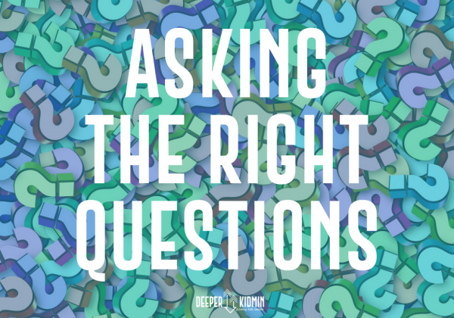
ESSENTIAL QUESTION
"Asking the right questions takes as much skill as giving the right answers." - Robert Half
What kinds of questions should I be asking as I read different texts?
This Photo by Unknown Author is licensed under CC BY-NC

Slide 4
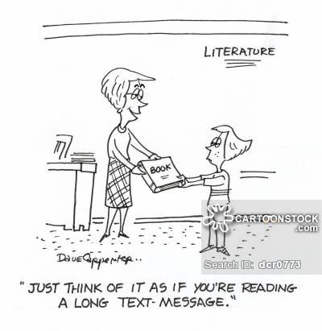
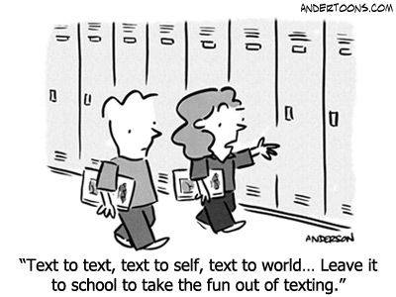
Objective of the Session
To provide a framework that guides students and teachers in asking and answering questions that increase and elevate student classroom discourse about texts
Notes:
https://d7199e1c-a-8ade7df0-s-sites.googlegroups.com/a/alaska.edu/diane-kardash/Home/making-connections/text%20connections%20comic.JPG?attachauth=ANoY7co30ooDXPKMB0yVDkGl0m161izbtejX4z5lgZgp_nI_mRq4-n1-tncE4o3kmmk9YCF_wGTY2nAb48glj7QVyKxH3851mfi4YO1CEFH1K2iBYPmDI1cVgqim6Oo4-LLESW_p9Km2rIvCoqcrRb7OROPCblAoNP5EAsNhPe38c3iy-wnRCHTjr_gJkDVQB1JlJFzVhTRpdKNuR4rjwhoB6kDc55f6W0V6GZhmmoNbflRxeHhcHobrt7Atg_XPjLcKBk_QYpMZ&attredirects=0
https://www.pinterest.com/pin/418412621606564580/?lp=true

Slide 5
Common Problems with Questioning
Students don’t always know how to find answers to more challenging questions about a text
Students don’t always see questioning as a reading and thinking strategy
“I already get it, I don’t have any questions”
Notes:
Talk about how some questions are too straightforward/boring but other questions can be frustrating if students can’t find the answer directly in the text: they need to know when to use the text, when to use their background knowledge, and when to use a combination of the two

Slide 6
Teaching Students a Framework for Questioning:
Question Answer Relationships (QAR)*
Helps them understand:
  Different types of questions and approaches to answering them
  The progression from factual details to higher order thinking focused on inference, comparison, synthesis, evaluation
  How to ask good questions for themselves
*http://www.adlit.org/strategies/19802/
Notes:
http://www.adlit.org/strategies/19802/
Fisher, D., and Frey, N, (2004). Improving Adolescent Literacy: Strategies at Work. New Jersey: Pearson Prentice Hall.
Raphael, T.E., & Au, K.H. (2005). QAR: Enhancing comprehension and test taking across grades and content areas. The Reading Teacher, 59, 206-221.

Slide 7
Different Types of Questions …. Require Different Strategies for Answering
In the Text |  | In My Head
Where to Find the Answer
On the Line | On Several Lines | Between the Lines | Beyond the Lines
The answer is usually EASY TO FIND (in one particular sentence) and EXPLICITLY STATED. | The answer is located in more than one sentence or paragraph. The reader must PUT different parts of the text TOGETHER to find the answer. The information is stated in the text and the reader answers the question by PULLING IT TOGETHER. | The answer is implied but not stated in the text. The reader must access prior knowledge about information provided by the author and make an INFERENCE. The answer to the question is IMPLICITLY STATED. | Readers must do their own thinking and rely on their OWN EXPERIENCES AND OPINIONS more than information in the text. The question may be asking them to relate information from the text to other ideas, to make judgments about something in the text, or to do RESEARCH USING OTHER SOURCES outside the text.
Adapted from The Question-Answer Relationships, Reading Apprenticeship
Notes:
Ask teachers to raise their hand if they’ve seen something similar before.
Ask teachers to raise their hand if they’ve used it in class before. (Use that information to guide what we talk about- whether we spend more time unpacking what the strategy is or talking about how to use it as a tool to generate student discussion)
Talk about how it’s important to ask a few “On the Line” (also called “Right there”) questions in order to ensure basic comprehension, but that “On Several Lines/Between the Lines” questions (also called search and locate/author and me questions) are much more engaging and show much deeper comprehension of a text. Beyond the Lines (also called “On my own”) questions can be used to build interest and help students make connections between the text and their own lives, but it’s also important to connect back to the text through “Between the Lines” (author & me) questions and not just ask tangential questions that don’t require them to use the text.

Slide 8
On the Line
The answer is usually EASY TO FIND (in one particular sentence) and EXPLICITLY STATED.
Example from Romeo and Juliet:
Where does Act I, Scene I take place?
Notes:
These are also called a “right there” type of question. https://iowareadingresearch.org/blog/question-answer-relationship

Slide 9
On Several Lines
The answer is located in more than one sentence or paragraph. The reader must PUT different parts of the text TOGETHER to find the answer. The information is stated in the text and the reader answers the question by PULLING IT TOGETHER.
Ex: How do Romeo and Juliet find out that
they are from feuding families?
Notes:
These are also called a “Think and Search” type of question. https://iowareadingresearch.org/blog/question-answer-relationship

Slide 10
Between the Lines
The answer is implied but not stated in the text. The reader must access prior knowledge about information provided by the author and make an INFERENCE. The answer to the question is IMPLICITLY STATED.
Must use text clues and prior knowledge

Slide 11
Between the Lines
Ex: How does Romeo feel right before they leave for the party?
Text Clues | In My Head Clues
my mind misgives | Misgives = have a bad feeling about
some vile forfeit of untimely death | I would feel scared
But He, that hath the steerage of my course, Direct my sail! | People capitalize “He” when talking about God- Romeo’s letting God take control
On, lusty gentlemen. | He’s not letting his feelings stop him from going
Notes:
These are also called an “Author and Me” type of question. https://iowareadingresearch.org/blog/question-answer-relationship

Slide 12
Beyond the Lines
Readers must do their own thinking and rely on their own experiences and opinions more than information in the text. The question may be asking them to relate information from the text to other ideas, to make judgments about something in the text, or to do research using other sources outside the text.
Ex: How would people today react if you
got married at 13, like Juliet?
Notes:
These are also called an “On My Own” type of question. https://iowareadingresearch.org/blog/question-answer-relationship

Slide 13
Adapted from The Question-Answer Relationships, Reading Apprenticeship

Slide 14
Preliminary Questions
Is anyone already familiar with this framework? Have you seen it used or used it yourself in the past?
What do you like about this framework – what positives do you see?
Is there anything you don’t like about the framework – what negatives do you see?

Slide 15
Using the Framework with
Thank You, Ma’am
by
Langston Hughes
(see handout)

Slide 16
Questions
In the Text |  | In My Head
Where to Find the Answer
On the Line | On Several Lines | Between the Lines | Beyond the Lines
Read the story “Thank You, Ma’am” individually. Then as a group, write examples of several questions of each type that you could use with students to discuss the story.
Think about how students would respond to an activity in which they need to develop their own discussion questions.
Notes:
Which questions do you think are most engaging for students?
Which questions help students apply themes from the story to their own lives?
Which questions help students analyze characters?
Which questions help students support arguments with evidence from the text?
When are “on the line” questions important? Engaging?

Slide 17
Which questions do you think are most engaging for students?
Which questions help students apply themes from the story to their own lives?
Which questions help students analyze characters?
Which questions help students support arguments with evidence from the text?
When are “on the line” questions important? Engaging?
Questions
In the Text |  | In My Head
Where to Find the Answer
On the Line | On Several Lines | Between the Lines | Beyond the Lines
Notes:
Which questions do you think are most engaging for students?
Which questions help students apply themes from the story to their own lives?
Which questions help students analyze characters?
Which questions help students support arguments with evidence from the text?
When are “on the line” questions important? Engaging?

Slide 18

Teachers Share Examples of Questions from All Categories

Slide 19
Using This Framework with Students
How much modeling would they need to be able to do it on their own?
How engaged would they be?
How much would they learn about the text?
How much would this help them in their own independent comprehension of texts?
How much would it help them in preparing for writing about texts?

Slide 20
How Could We Use This
Framework with Students?
Have students use this framework to ask and answer their own questions in a small group discussion
Have students categorize the questions that they are being asked in a class activity
Have students use a graphic organizer to keep track of the in-the-text and in-my-head clues they used to answer questions in a lesson

Slide 21

Teacher Personal Reflection Time
Use the questions on the reflection form to think about how you might use what you have learned today and begin planning for the future…
This Photo by Unknown Author is licensed under CC BY-SA

Slide 22
Summing Up
Quick feedback/questions (if time)
Sample lesson plan as take-away
Please let us know if you decide to try this with a class and how it goes
Thanks for participating!

