Slide 1


Reflecting on Student Work, Student Progress, and Next Steps for Continuous Improvement

Slide 2
Guiding Questions for the Series
How do we motivate students to engage in rigorous academic work?
How can we adapt our classroom instructional practices to tap into students’ intrinsic motivation?
How can we do this as a collaborative community?

Slide 3
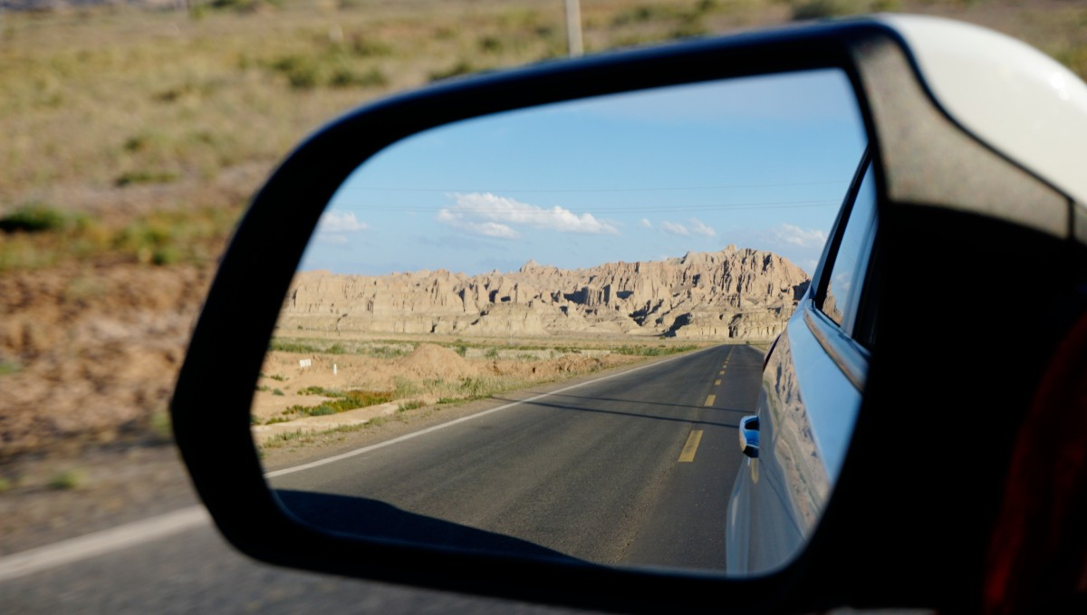
Where have you come from and where are you going?
(Genesis 16:8)

Slide 4
Motivation Components – BRACE
B
Belonging
R
Relevance
(Purpose)
A
Autonomy
C
Competence
(Mastery)
E
Engaging
Interest

Slide 5
Building Community
Relevance/
Engaging Instruction
Choice/Autonomy
Monitoring Student Progress
Grading/Assessment

Slide 6

Building Community
Getting to know your students
Connecting learning to students’ lived experiences and culture
Cooperative learning strategies
Notes:
Image credit: Alpha Stock Images – http://alphastockimages.com

Slide 7

Relevance/Engaging Instruction
Reframing objective
Authentic Assignments
Project-Based Learning

Slide 8
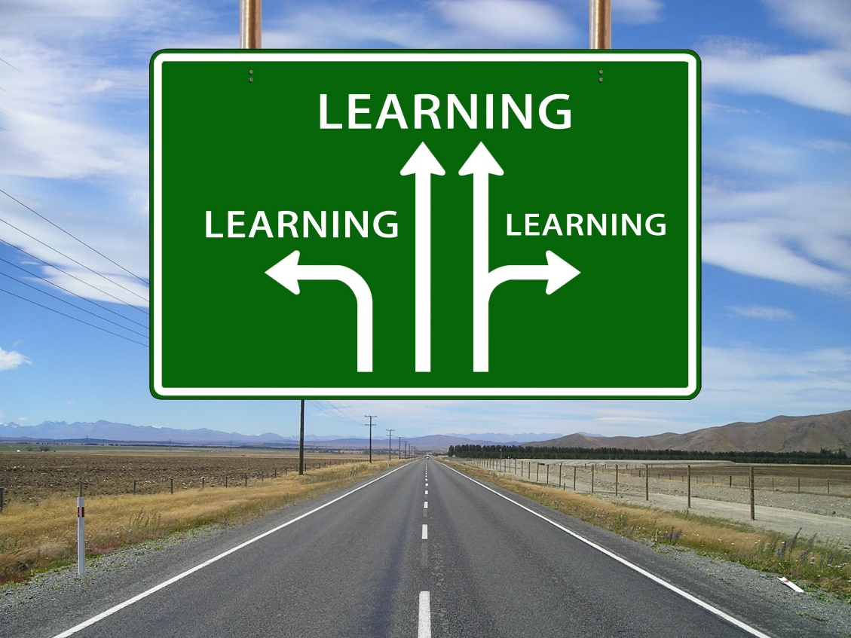
Choice/Autonomy
Providing menus and options for students to choose

Slide 9

Monitoring Student Progress
Providing students with tools to monitor their own progress
Helping students reflect on their own progress

Slide 10
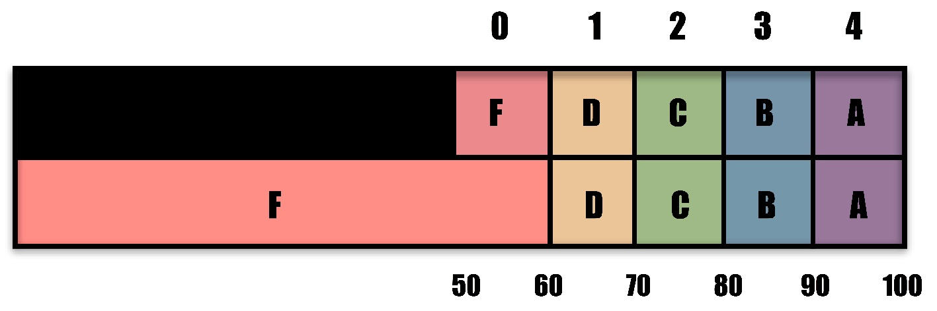
Grading/Assessment
100 vs 5 point scale
Power of 0
Opportunities for recovery

Slide 11
Reflection Exercise
Create a visual representation of your journey this year in teaching, addressing the following questions:
What have I done differently this year in my teaching to seek to engage more students more deeply in academic work?
How has it worked? What have I learned from what I have tried?
What changes in student engagement and student outcomes have I seen?
How has this impacted me?
What next steps do I need to take in a continuous improvement process?

Slide 12

Share your journey
Pose questions to your colleagues

Slide 13
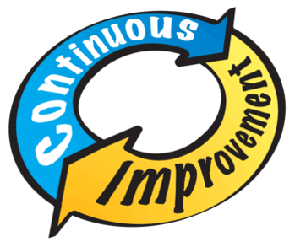
How do I sustain an effective continuous improvement process in my practice?

Slide 14
Start with a Problem of Practice
Develop a Theory of Action
Plan to Collect and Use Evidence of Progress
Take Action
Understand What Happened
Cycle of Inquiry Process
Honig and Ishimaru, 2013
Notes:
A key foundation of understanding of my presentation is a general understanding of the Cycle of Inquiry Process: this is consistent with the AWSP, Danielson, and Keeping our Promise Action Plan which cycles of inquiry require a disciplined approach to thinking, questioning, and acting all of which is consistent with the Keeping our Promise Action Plan (explicit connections to what we are already doing, learning).
In relation to the Promise Action Plan, Cycles of Inquiry work is aligned to creating a systemic approach to aligning gap closing strategies into an effective, coherent, system-wide approach (the case for urgent action). A cycle of inquiry approach to adult learning centered on outcomes for all students, specifically traditionally marginalized and underperforming populations is a systems-wide response of the Action Plan.
The parts of the Cycle of Inquiry Process are highlighted here: Starting with a problem of practice, developing a theory of action, collecting and using evidence of progress, taking action, and understanding what happened.
Honig and Ishimaru, 2013

Slide 15
Plan – Do – Study – Act Cycle
What did you conclude?
Plan
I plan to:
Do
What did you observe when you did this?
Study
What did you learn?
What changes might you attempt in the next cycle?
I hope this produces:
Steps to execute:
Did you meet your goal?
Act

Slide 16

Thanks so much for your participation in
this journey!

