Slide 1


Helping Students Track
Their Progress in Meeting Learning Goals

Slide 2
“Arguably the most basic issue a teacher can consider is what he or she will do to establish and communicate learning goals, track student progress, and celebrate success.”
Robert J. Marzano, The Art and Science of Teaching

Slide 3
A Sense of Accomplishment/Mastery/ Competence is One Source of Motivation
Students need to have a way of monitoring their progress in mastering learning targets.
Studies show that “when students track their own progress on assessments using graphic displays … [there was] a 32 percentile point gain in their achievement” (Marzano, 2009, p. 1).

Slide 4
Guiding Questions
How are we helping students to monitor their progress in meeting learning goals?
In what ways do grades help students monitor their progress in learning?
In what ways might grades not be as helpful as we might think in helping students monitor their learning progress?
What do students whose grades indicate they are not succeeding need in order to make progress and experience success?

Slide 5

Reports from the Field
How are students checking their grades on the portal?
What kind of guidance do they receive?
Are all students doing this?
What impact does this seem to be having?

Slide 6


Group Discussion Using Google Docs

Slide 7
On your computer, open Chrome
At the top right, click: › New Incognito Window
- or -
you can use the following keyboard shortcut:
  On a PC: Press Ctrl + Shift + n
  On a Mac: Press ⌘ + Shift + n
Next, follow the case sensitive link provided to you
If you see someone around you have tech trouble, please lend a helping hand
Please help everyone get the most out of this activity by keeping the environment as quiet as possible 😊

Slide 8

Small Group Discussion
In what ways do grades help students monitor their progress in learning?
What else might students need to be able to reflect on and respond to their learning progress?

Slide 9

Small Group Discussion
In what other ways (besides giving grades) are you currently helping students monitor their learning progress in your classes?

Slide 10

Share Out

Slide 11
Examples of Helping Students Track Their Learning Progress

Slide 12
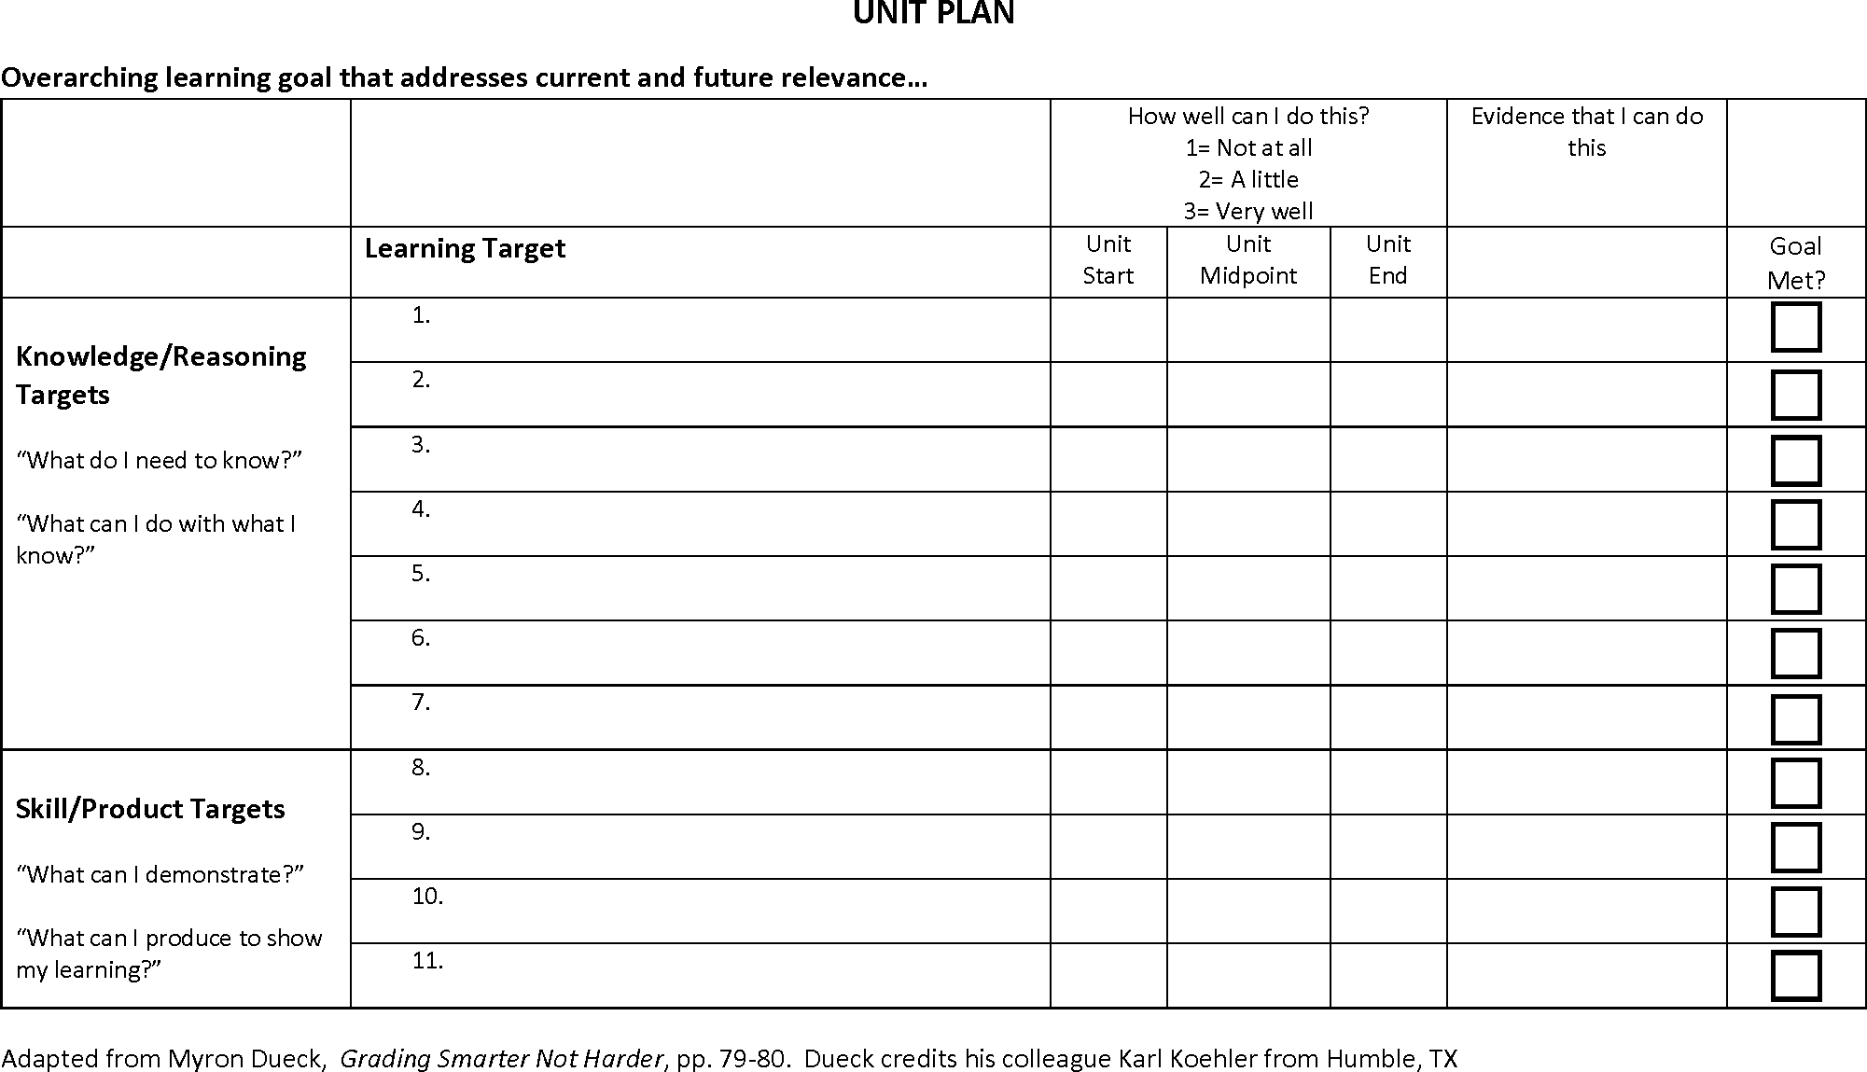

Slide 13
Tracking Progress in Specific Mathematics Skills:
Making sense of problems and perseverance in solving them
Reasoning abstractly and quantitatively
Constructing viable arguments
Attention to precision

Slide 14
Providing Structure for Students to Track Progress
Providing tables for students to keep track of rubric scores on different writing skills over time:
Each paragraph includes specific evidence to support my claims
4
3 |  |  |  |  | *
2 |  | * | * | *
1 | *
0
 | Paper 1 | Paper 2 | Paper 3 | Paper 4 | Paper 5

Slide 15

Keeping student work portfolios to use in student-teacher conferences to reflect on work progress over time

Slide 16

Small Group Sharing
Take a couple of minutes to look over the examples in your folder
Then discuss with those seated near you:
  What thoughts are emerging for you about designing and implementing a regular, systematic way for students to:
    monitor their progress on learning goals?
    reflect on steps they need to take to grow in mastery?

Slide 17
Reflecting on Grading and Assessment

Slide 18
How Many at Our School Are Not Succeeding?
Notes:
Need to edit and replace with your school’s data

Slide 19
How Many at Our School Are Not Succeeding?
Notes:
Need to edit and replace with your school’s data

Slide 20

Opening up the gradebooks

Slide 21
What % of My Students Are Currently Not Succeeding in My Classes?
 | Class 1 | Class 2 | Class 3 | Class 4 | Class 5
Number of students below 60
Number of students in class
% below 60

Slide 22
Department Discussion Using Google Docs

Slide 23
Department Discussing Using Google Docs
Please go to the most appropriate link based on the courses you teach
Type goo.gl/ followed by:
Remember, links are case sensitive!
English add link
World Languages add link
Math add link
Science add link
Social Studies add link
Fine Arts add link
CTE add link
PE add link
General Special Ed add link

Slide 24
Questions to Ponder
What are the main reasons your students are not succeeding?
What steps do these students need to take to be able to pass this semester?
What supports do these students need to help them recover?
For how many of your students is it already too late to pass this semester?

Slide 25
Next Steps
What next steps need to happen for students who are failing?
Are there policies or practices currently in place that, if changed, would help us help more students succeed the first time they take a course?

