Slide 1
Using Project-Based Learning to Deepen Learning and Engagement

Slide 2
Project-Based Learning (PBL)
Learning by doing
Real world connection
Engages student interest
Associated with higher or equally high student academic achievement outcomes
Teaches skills for real world of work

Slide 3
Agenda
Teachers engage in short PBL experience
Debrief about learning from the experience
Videos and discussion about how students perceive PBL
Explore site with example PBL units in different subject areas
Reflect on how you may be able to incorporate PBL in your classroom

Slide 4
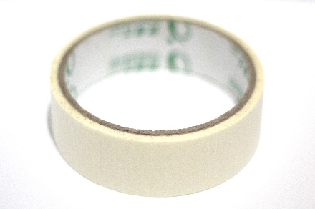
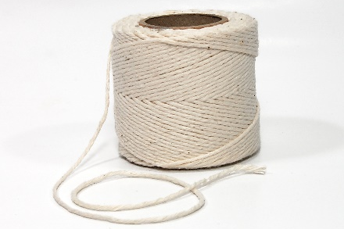
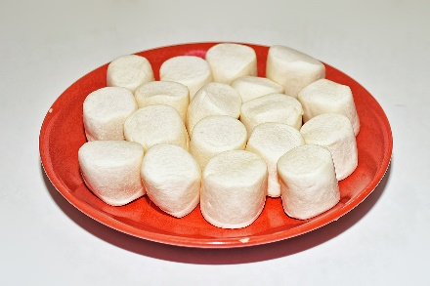
Marshmallow Tower Challenge
In 18 minutes, build the tallest free-standing structure out of 20 sticks of spaghetti, 3 feet of tape, 3 feet of string, and 1 marshmallow. The marshmallow must be on top.
Notes:
Spaghetti image: Marco Verch, https://www.flickr.com/photos/149561324@N03/46027022024
Tape image: wian, https://pixabay.com/photos/tape-paper-tape-artist-tape-clear-3682989/
String image: Fcb981, https://en.wikipedia.org/wiki/File:Spool_of_string.jpg
Marshmallow image: Choo Yut Shing, https://www.flickr.com/photos/25802865@N08/15037021452/

Slide 5
Marshmallow Tower Challenge
Task: Build a free-standing tower that will support the weight of one regular-sized marshmallow on top
Materials (do not all need to be used):
20 pieces of uncooked spaghetti
1 yard of tape
1 yard of string
1 marshmallow

Slide 6
Notes:
Tower image: IDEO, https://www.flickr.com/photos/ideopostcards/6988820848
Spaghetti image: Marco Verch, https://www.flickr.com/photos/149561324@N03/46027022024
Tape image: wian, https://pixabay.com/photos/tape-paper-tape-artist-tape-clear-3682989/
String image: Fcb981, https://en.wikipedia.org/wiki/File:Spool_of_string.jpg
Marshmallow image: Choo Yut Shing, https://www.flickr.com/photos/25802865@N08/15037021452/

Slide 7
Debrief of Marshmallow Tower Challenge
As a learner, what did you learn from this challenge?
What made this activity engaging or motivating?
To what extent might students be able to learn from such an experience as the Marshmallow Tower challenge, even though it is not related to course content?

Slide 8
Debrief of Marshmallow Tower Challenge
What is needed to create a project that requires collaboration?
What skills do students need to collaborate effectively?
What collaboration skills may need to be taught to students and scaffolded rather than assumed?

Slide 9
How Do Students Experience PBL?
Notes:
Image credit: Karabo, https://commons.wikimedia.org/wiki/File:Groupwork.jpg

Slide 10
INSERT VIDEO HERE
http://www.bie.org/object/video/it_really_actually_changed_my_life
When you register at Buck Institute for Education PBLWORKS www.bie.org, you can access this video to show to teachers (at no cost)
Notes:
We did not include the actual video clip here because of new BIE Terms of Use.

Slide 11
Debrief of PBL Video
What did you find striking or interesting about student perceptions of PBL?
How do the points made by students match your experience as an educator?

Slide 12
Barriers and Obstacles to PBL

Slide 13
5 Keys to PBL
Establishing Real-World Connections
Core to Learning
Structured Collaboration
Student-Driven
Multi-faceted Assessment
From http://www.edutopia.org/video/5-keys-rigorous-project-based-learning

Slide 14
PBL Exploration
We will explore more ideas for PBL
Check out this resource: www.pblworks.org
Register (free) to get access to resources
Examine the various topics, and generate an idea for a project you could implement in your classroom
Notes:
The slides about pblworks.org were updated in January 2020 from a previous version to reflect changes to the website. Users should check pblworks.org to determine if the current version is still appropriate.

Slide 15
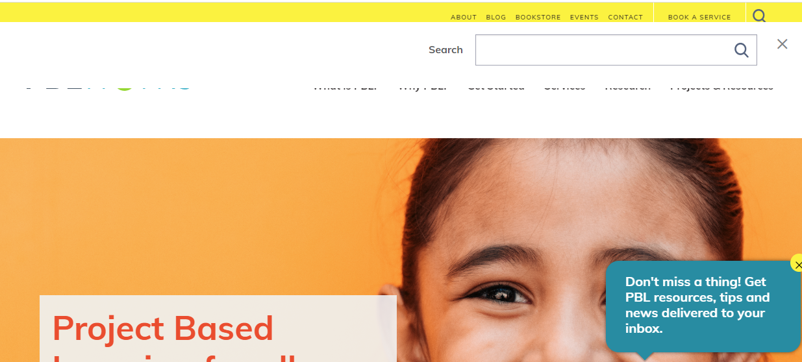
www.pblworks.org
Notes:
The slides about pblworks.org were updated in January 2020 from a previous version to reflect changes to the website. Users should check pblworks.org to determine if the current version is still appropriate.

Slide 16
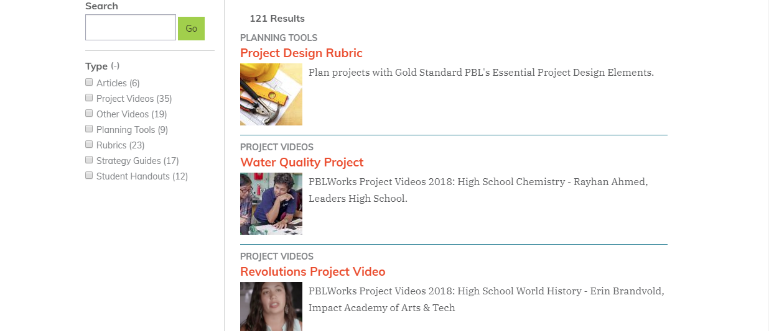
my.pblworks.org/resources
Notes:
The slides about pblworks.org were updated in January 2020 from a previous version to reflect changes to the website. Users should check pblworks.org to determine if the current version is still appropriate.

Slide 17
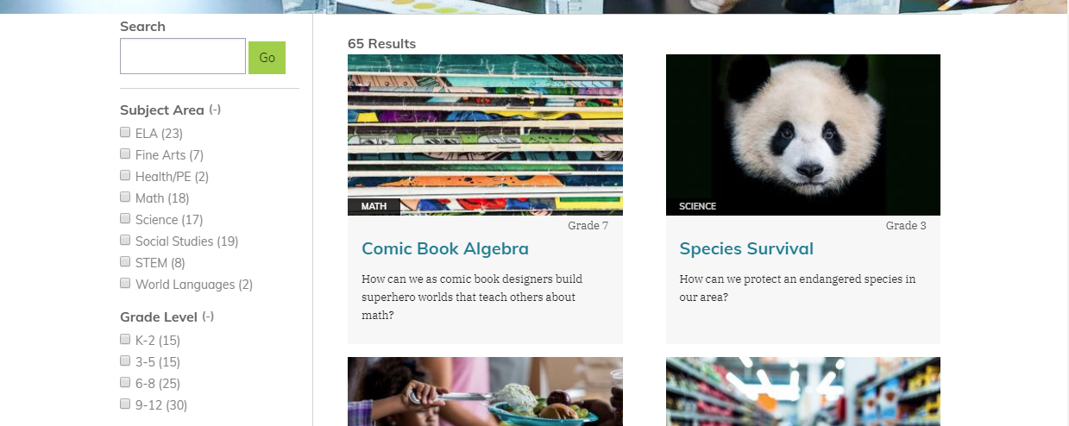
my.pblworks.org/projects
Choose a subject – get links to sample units
Notes:
The slides about pblworks.org were updated in January 2020 from a previous version to reflect changes to the website. Users should check pblworks.org to determine if the current version is still appropriate.

Slide 18
Examples of projects under “Health/PE”
Notes:
The slides about pblworks.org were updated in January 2020 from a previous version to reflect changes to the website. Users should check pblworks.org to determine if the current version is still appropriate.

Slide 19
Examples of projects under “Fine Arts”
Notes:
The slides about pblworks.org were updated in January 2020 from a previous version to reflect changes to the website. Users should check pblworks.org to determine if the current version is still appropriate.

Slide 20
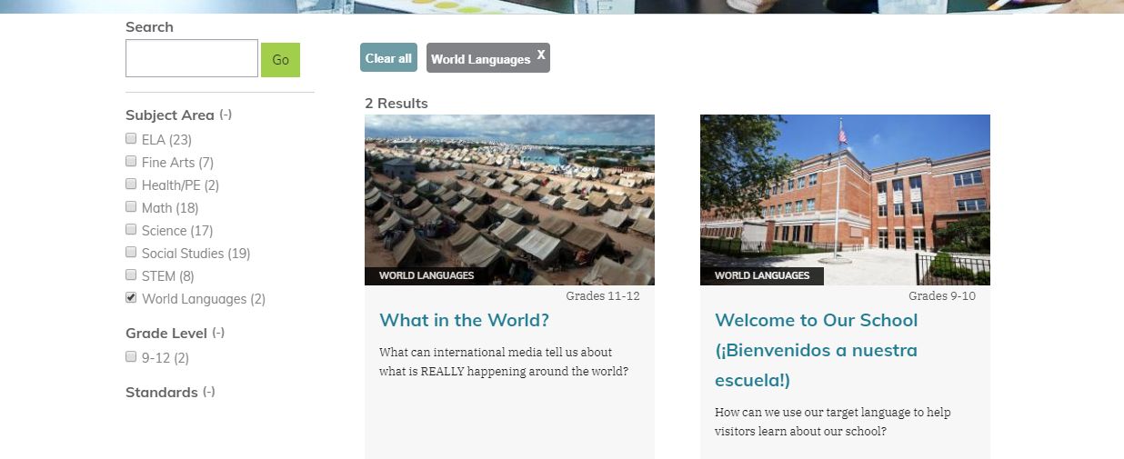
Examples of projects under “World Languages”
Notes:
The slides about pblworks.org were updated in January 2020 from a previous version to reflect changes to the website. Users should check pblworks.org to determine if the current version is still appropriate.

Slide 21
Teacher Reflection
What upcoming units and/or content standards could be addressed through a project-based learning approach?
What next steps could I take to plan a PBL mini-unit?
What resources and/or information do I need and how will I obtain these?
When and with whom will I discuss my planning further?

Slide 22
For Final Upcoming Session: Volunteer to Share From Your Practice
What have I done differently this year in my teaching to seek to engage more students more deeply in academic work?
How has it worked? What have I learned from what I have tried?

