Slide 1


Problems in Context
Lesson Planning for Authentic Mathematical Tasks

Slide 2
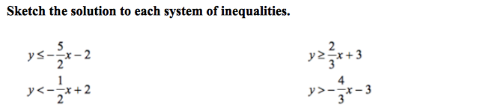
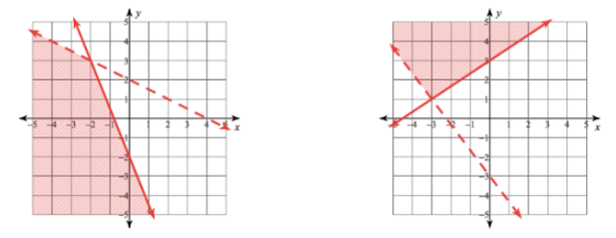
The Traditional Approach:
Systems of Inequalities

Slide 3
The Traditional Approach
Students are…
taught a step-by-step process for a specific skill/procedure
given a set of near-identical problems with which to practice
assessed on “mastery” of skill
taught subsequent skills and procedures that progress in a linear fashion
expected to be able to make connections between skills and transfer knowledge to applied situations

Slide 4
The Traditional Approach
content knowledge is often disjointed
learning is rarely presented within a meaningful context, and if so, often at the end of the lesson/unit
contributes to the belief that mathematics is irrelevant
students become under-developed in crucial other mathematical competencies
  justifying methods; representing ideas, concepts, and patterns; creating charts/graphs/pictures; etc.

Slide 5
The Contextual Approach
The
Dating Zone
Problem
Systems of Inequalities In Context
Adapted from the Mathalicious lesson “Datelines”
https://www.mathalicious.com/lessons/datelines

Slide 6
The Dating Zone
When looking to date someone who’s a different age from yourself, how much younger than you is too young? How much older than you is too old?
Some people use the “half-plus-seven” rule

Slide 7
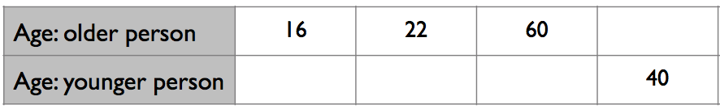
The “half-plus-seven” rule:
Take your age, cut it in half, and then add seven. That number is the age of the youngest person you can date.
66
15
18
37

Slide 8
The youngest you can date…
“half-plus-seven”
in words:
  “half of my age, plus seven years gives me my date’s age”
as an equation:
  a÷2 + 7 = d

Slide 9
The oldest you can date…
the reverse of “half-plus-seven”
in words:
  “if I subtract seven years from my age, then double it, I have
  my date’s age”
as an equation:
  (a-7)2 = d

Slide 10
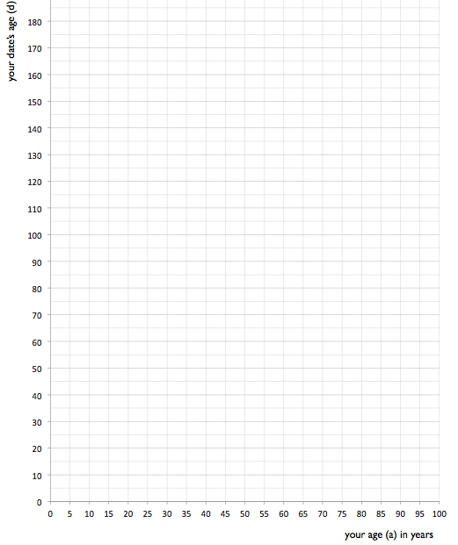
•
upper age limit
(a-7)2 = d
•
•
•
•
a÷2 + 7 = d
lower age limit
•
•
•

Slide 11
•
upper age limit
(a-7)2 ≥ d
•
•
•
•
a÷2 + 7 ≤ d
lower age limit
•
•
•

Slide 12



•
upper age limit
(a-7)2 ≥ d
•
•
•
•
a÷2 + 7 ≤ d
lower age limit
•
•
•

Slide 13
Extensions
If someone is out of your Dating Zone will they ever be in it?
Will Edward and Bella ever be in the Dating Zone? If no, why not? If yes, when?

Slide 14
The Half-Plus-Seven Task
Writing equations/inequalities
Plotting points
Graphing lines/inequalities
Interpretations
Strategy: using test points for inequality solutions
Strategy: using a table to create coordinates
Equations
Inequalities
Shaded and non-shaded regions
Intersection of lines
Meaning of expanded zone

Slide 15
Work Session
Select an upcoming mathematical concept you are planning to cover
Identify an authentic context in which that mathematical concept is applicable
Use the provided planning guide to build a lesson (or modify an existing one) around that context
  The focus is to guide and support students through the task
  Limit the amount of direct instruction as much as possible

Slide 16
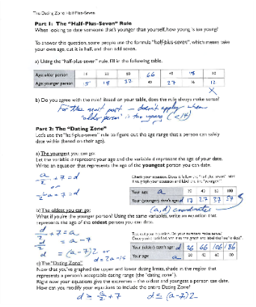
Work Session
Select an upcoming mathematical concept you are planning to cover
Once you’ve selected or designed a task, go through it from start to finish
As you plan, consider:
  Misconceptions
  Information students will need
  Guiding hints and questions you can provide
  How content knowledge will be conveyed
  How support will be given

