Slide 1


What Motivates Students to Do Academic Work?

Slide 2
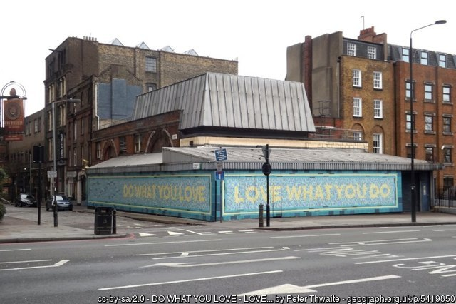

Icebreaker – What is your passion?

Slide 3

Passion Profiles
Passion 1: The Child
Passion 5: The Relationship Between Beliefs and Professional Practice
Passion 2: The Curriculum
Passion 6: The Intersection Between Your Personal and Professional Identities
Passion 3: Content Knowledge
Passion 7: Advocating Equity and
Social Justice
Passion 4: Teaching Strategies and Techniques
Passion 8: Context Matters

Slide 4
Passion Profiles
Determine your passion
Meet passion team @ station
Share highlights with large group

