Slide 1


Engaging Students in Science
Through Discussion of
Science News Articles

Slide 2

Guiding Question
How can we use scientific news articles to build students’:
understanding of the applicability and relevance of
science content
interest in science content
critical analysis reading skills
academic discussion/writing skills
skills at working in groups

Slide 3
Session Agenda
Group discussion about using science articles
Small group discussion/critique of example lesson plan and large group debrief
Individual lesson planning time
Wrap-up discussion

Slide 4
Group Discussion Questions
To what extent do you use brief articles or texts in your science class to:
Increase interest in science content?
Build student non-fiction reading and analysis skills?
What are some of the obstacles or challenges to doing this?
How does this work in a small group setting?

Slide 5
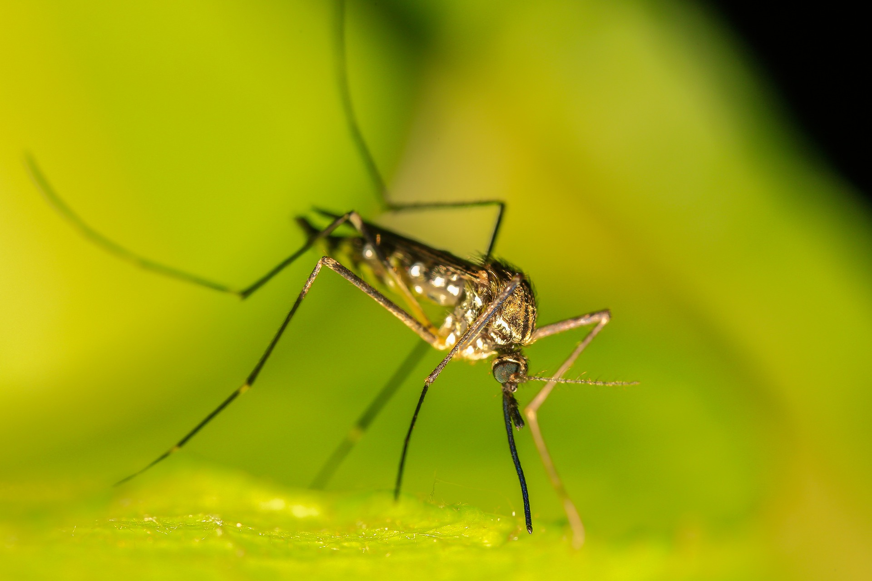
New Weapon to Fight Zika: The Mosquito
Critiquing a Lesson Plan

Slide 6
Critiquing a Lesson Plan
As a group, review together the lesson plan on the handout.
Keep the following overarching questions in mind for each section/activity:
How feasible is it to execute?
How would your current students react to such a plan? Would they be engaged?
What changes would you suggest to improve this lesson plan?
What learning activities/performance tasks are involved, and what do you think of them?

Slide 7
Applying This to Our Science Classrooms
Group Discussion
How likely is it that you might use something similar to this lesson? What adaptations do you foresee having to make?
How feasible would it be to use this kind of format and lesson plan for particular science topics in your curriculum?
What kinds of topics would both be of interest to students and relevant to your course content?

Slide 8
Resources for Science Articles
Science News for Students https://www.sciencenewsforstudents.org
STEM Articles from New York Times https://www.nytimes.com/spotlight/learning-stem
Newsela Science Articles https://newsela.com/search?needle=Science

Slide 9
Teacher Personal Reflection Questions
How can I envision using a science article discussion activity in my classroom? (If not at all, why not?)
What challenges do I expect in implementing this activity and how can I address those challenges proactively?
What steps would I need to take in planning for and implementing such an activity?

