Slide 1


Engaging Students in Science Through Discussion of Science News Articles

Slide 2
Guiding Questions
How might science news stories capture students’ natural interests to engage them in learning science content, concepts and practices?

Slide 3
Session Agenda
Experience a “Science News” activity
Debrief the experience and examine as a department
Explore the site for potential use in an upcoming unit in your classroom

Slide 4
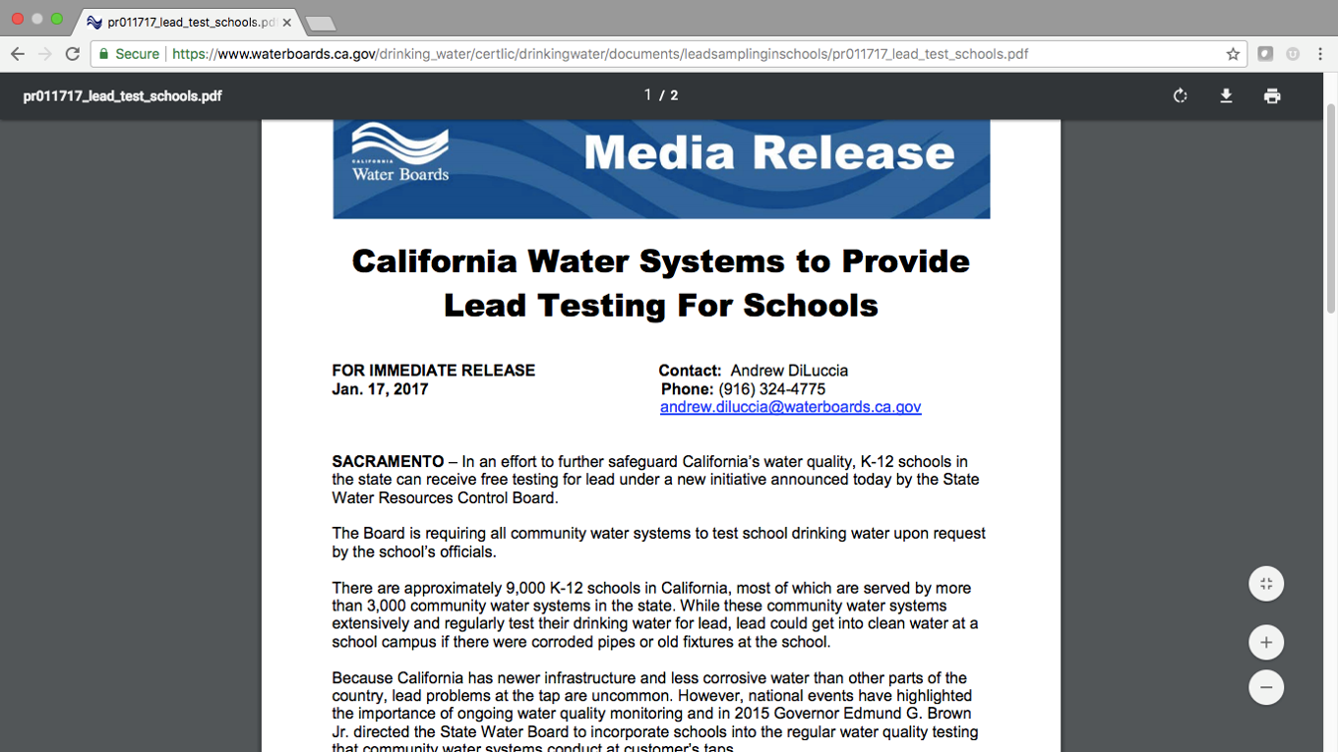

Slide 5
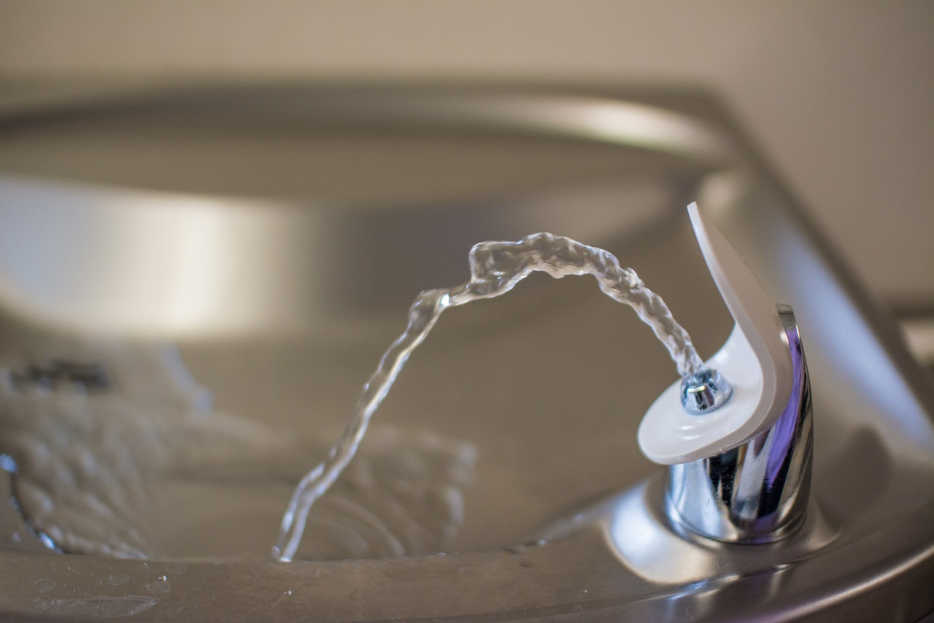
How confident are we about our drinking water
at our school?

Slide 6
Features of “Science News for Students”
https://www.sciencenewsforstudents.org
Power words
Data dive
Real data on lead levels in school drinking water

Slide 7
Directions for Student Reading in Pairs
Decide who will be A and who will be B
EITHER read the first paragraph silently OR A reads aloud – B follows along
B paraphrases the content
EITHER read the second paragraph silently OR B reads aloud – A follows along
A paraphrases the content
Continue through the remainder of the article

Slide 8
Pairs Combine into Fours
Discuss the first two data dive questions
Select the graph for just one school to discuss question three

Slide 9
Whole Group Discussion Questions
If the water was tested again, what are your hunches about how the results might be different?
How might you present this data?
Review the Lead Sampling in California handout.
What questions does this raise?

Slide 10
Debrief
Thoughts about this experience?
How might students respond to this?
How might this type of activity address the curriculum?

Slide 11

Conceptual Shifts in the NGSS
K–12 science education should reflect the real world interconnections in science
Using all practices and crosscutting concepts to teach all core ideas all year
Science concepts build coherently across K-12
The NGSS focus on deeper understanding and application of content
Integration of science and engineering
Coordination with Common Core State Standards

Slide 12

Framework for K-12 Science Education & Next Generation Science Standards (NGSS)
1. Scientific and Engineering Practices NSES – Process Skills, Inquiry, and Nature of Science | 2. Crosscutting Concepts NSES – Unifying Concepts | 3. Disciplinary Core Ideas NSES Science Content Adds Engineering and STEM
Asking questions (for science) and defining problems (for engineering) Developing and using models Planning and carrying out investigations Analyzing and interpreting data Using mathematics and computational thinking Constructing explanations (for science) and designing solutions (for engineering) Engaging in argument from evidence Obtaining, evaluating, and communicating information | Patterns Cause and effect: Mechanism and explanation Scale, proportion, and quantity Systems and system models Energy and matter: Flows, cycles, and conservation Structure and function Stability and change Utilizes History of Science and Social and personal perspectives | Physical Sciences Life Sciences Earth and Space Sciences Engineering, Technology, and the Applications of Science

Slide 13
Time to Explore the Site
What news pieces are available that align with content in my upcoming curriculum?
Which scientific and engineering practices might the activity be designed to address?
What resources or actions would I need to do next to try this out?

Slide 14
Teacher Reflection Questions
What steps do I need to take to use this resource in the design of engaging and effective lesson plans?
What resources would be helpful?
With whom will I discuss this more?

