Slide 1


Fact or Fiction? Distinguishing Fake News from Real News
Engaging Students in
Critical Reading Skills

Slide 2
Guiding Question
How can I leverage students’ natural interests to engage them in building one of the most critical skills in contemporary society:
The ability to evaluate information from the media

Slide 3
What evidence do we have about students’ ability to evaluate information?
How can we engage students in learning how to evaluate information they encounter?
How can we increase students’ ability to identify and reject unreliable information?

Slide 4
Wall Street Journal Headline
Most Students Don’t Know When News Is Fake, Stanford Study Finds
Teens absorb social media news without considering the source; parents can teach research skills and skepticism
WSJ, November 21, 2016

Slide 5
Reactions?
Do you tend to believe this headline, or find it questionable?
Why? What factors help to explain your reaction?
Most Students Don’t Know When News Is Fake, Stanford Study Finds
Teens absorb social media news without considering the source; parents can teach research skills and skepticism
WSJ, November 21, 2016

Slide 6
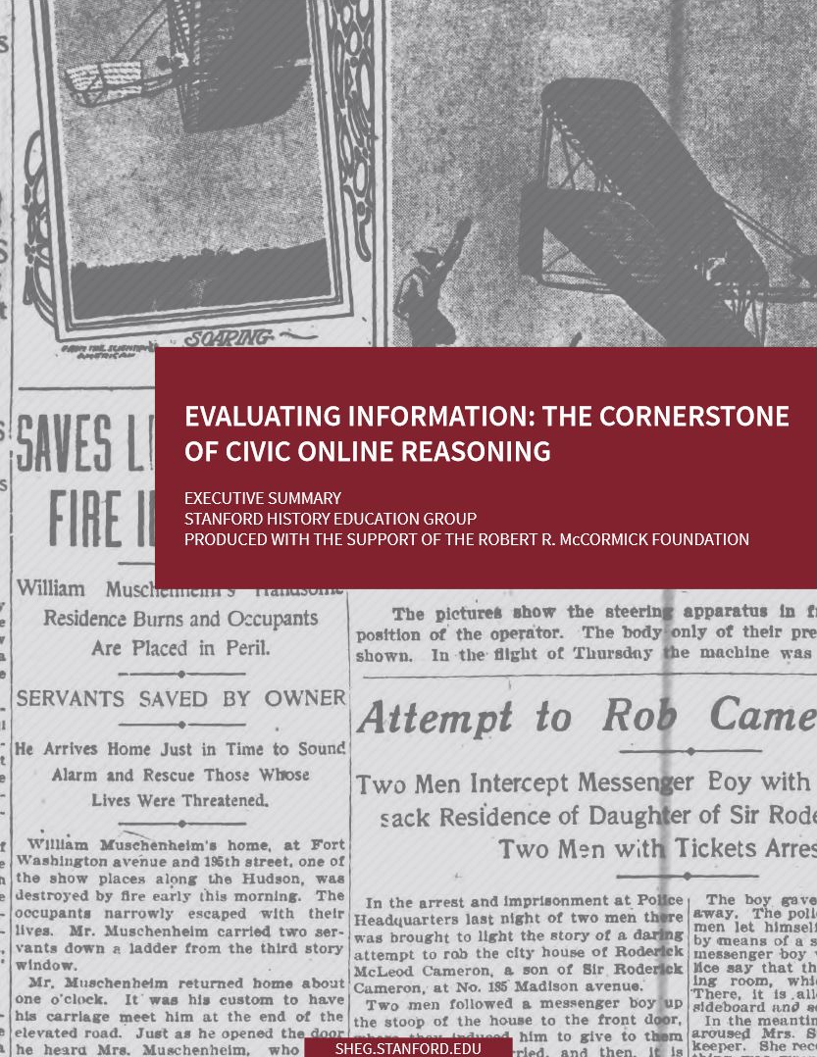
Findings from the Stanford Study
Fewer than 1 in 5 high school students “questioned the source of the post or the source of the photo” in a claim about the effects of radiation on plant life after the Fukushima disaster
Fewer than 1 in 5 middle school students can distinguish between native advertisements (identified as “sponsored content”) and news stories

Slide 7
“Overall,” the report concluded, “young people’s ability to reason about the information on the internet can be summed up in one word: bleak.”
Chris Berdik
http://www.slate.com/articles/technology/future_tense/2016/12/media_literacy_courses_help_high_school_students_spot_fake_news.html

Slide 8

News Stories
Fact or Fiction?

Slide 9
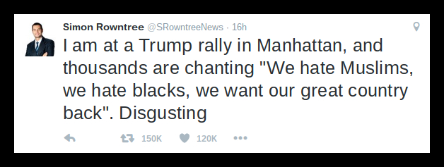

Slide 10
WikiLeaks CONFIRMS Hillary Sold Weapons to ISIS… Then Drops Another BOMBSHELL!
Read more: http://thepoliticalinsider.com/wikileaks-confirms-hillary-sold-weapons-isis-drops-another-bombshell-breaking-news/#ixzz4aZDSK6EL

Slide 11
Small Group Discussion Exercise
(How might something like this work in your classroom?)
Teachers will play the roles of students divided into small groups to accomplish the following tasks collaboratively:
Read the “news” story assigned to your group.
Develop a list of questions you need to find answers to in order to evaluate whether the “news” story is reliable or not.
List the questions in a logical order on your poster chart.
Suggest at least one good way to find the answer to each question, and be ready to defend why it is a good approach.

Slide 12
Large Group Share-Out

Slide 13
Teacher Reflection on Where Students
Will Need Scaffolding
Which questions do you think your students will be able to come up with themselves?
Which questions do you think they will probably not think of?
Are there ways to probe and help students discover what they need to know without telling them directly? (And why might it be important to do this?)
What methods for answering their questions are students likely to suggest? Where will they need guidance in finding reliable sources?

Slide 14
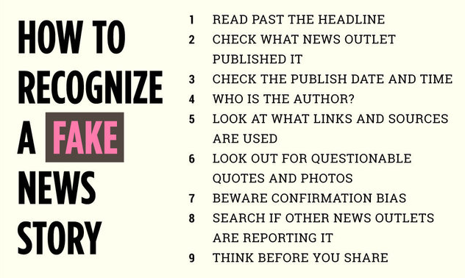
What are the pros and cons of teaching such a checklist prior to asking students to consider coming up with such a list on their own?
Huffington Post, November 22, 2016

Slide 15

Addressing the Issue of “Fake News” in My Classroom
How can I fit this into my curriculum?
What standards does this address?
What do I need to do next to try this out?

Slide 16
Reading Informational Text Standards
(CCSR Grades 9-10 for ELA and SS)
I can determine the author’s point of view in a text. (RI 6-1)
I can determine the author’s purpose for writing a text. (RI 6-2)
I can analyze accounts of the same subject told in a different medium, determining which aspects are emphasized in which medium. (RI 7-1)
I can assess whether an author’s reasoning is valid and whether s/he has enough relevant evidence to support the claims s/he makes. (RI 8-2)
I can identify false statements and fallacious reasoning. (RI 8-3)

Slide 17
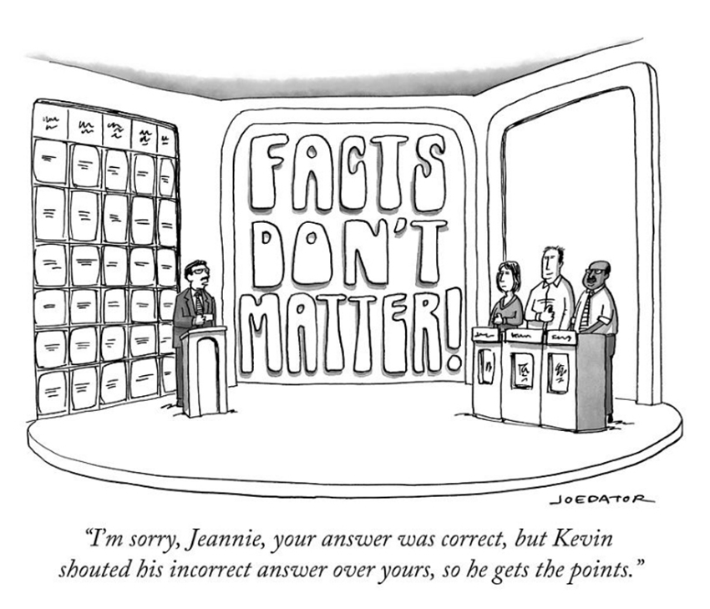
Ideas for Engaging Students in Identifying
Fake News
Cartoon by Joe Dator, The New Yorker

Slide 18
Additional Ideas for Engaging Students in Identifying Fake News
Teachers peruse and discuss distributed
lesson plan ideas and their own ideas

Slide 19
Teacher Reflection Questions
What student interests am I aware of that can provide a segue to engaging them in the importance of distinguishing fake news from real news?
How can I link this topic to upcoming topics in my curriculum?
What steps do I need to take to design engaging and effective lesson plans on this topic for my students? What resources would be helpful? With whom will I discuss this more?

