Slide 1


Connecting the Work to Students’ Future Work Lives
Creating Assignments with Student Products for Real Audiences

Slide 2

Image credit: John DeRosier, https://www.timesunion.com/opinion/slideshow/Cartoon-Gallery-John-DeRosier-s-View-7780.php

Slide 3
How can we create experiences for students that are relevant, engaging and more like the real world?

Slide 4
Agenda
Silent conversation activity and debrief
What are Authentic Assignments (and how often do we give them)?
Giving students a framework for attacking authentic assignments – 4 Ds of Problem Solving

Slide 5
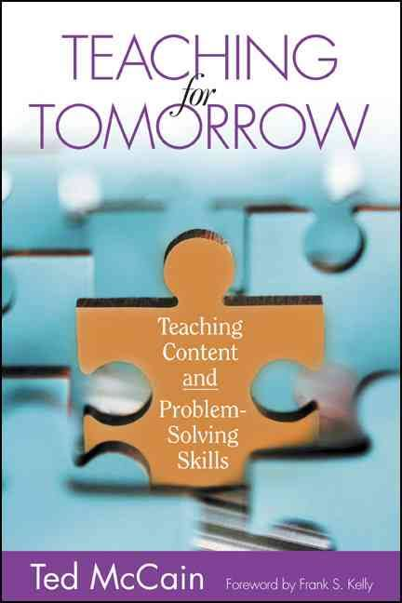
Reading Excerpt from Ted McCain
Read the excerpt from Teaching for Tomorrow
Think about:
  ASSUMPTIONS the author holds
  Things you AGREE with
  Things you want to ARGUE with
  Things you want to ASPIRE to
Notes:
We are going to use a couple of learning strategies that you can also use in your classrooms: we will do a silent discussion using the 4 A’s protocol in your binder.

Slide 6
Silent Conversation Steps
Use the large post-it sheets to write a reaction to the text (assumptions, something you agree with, something you want to argue with, something you want to aspire to)
Post your comments on the appropriate large sheet on the wall
Read the comments of others
Respond in writing to comments of others as you feel led
Notes:
make sure that the letter has been passed out ahead of time
Takes lass than 1 minute to read

Slide 7

Gallery Walk
Read and reflect on the conversations generated

Slide 8
Large Group Debrief
What were some themes that emerged in the conversation?
Did interacting with others’ opinions influence any of your original opinions?

Slide 9
Debrief on the Activity Strategy
What did you like about the silent conversation activity? Anything you did not like?
How do you think a silent conversation activity would work with students?
What might you need to change/adapt to make this work in your classroom?
How likely are you to try something similar (with a text or visual representation from your specific curriculum)?

Slide 10

Taking smaller steps before plunging into McCain-style real world scenarios…

Slide 11
Authentic, Real World Assignments Involve at Least One of the Following:
Authentic problem – a problem or situation that can and will occur in the real world
Authentic task – a task that people perform in the work world
Authentic process – a set of instructions and parameters that are similar to a real world or work experience
Authentic audience – a product or performance shared with a particular group of people (outside the classroom)

Slide 12

How Frequently Do Your Assignments
Involve an ..
Authentic problem
Authentic task
Authentic process
Authentic audience
Use handout sheet to estimate

Slide 13
Examples of
Authentic Assignments

Slide 14

Volunteers?

Slide 15
How Can Assignments Resemble Real World Job Assignments?
Some Examples

Slide 16
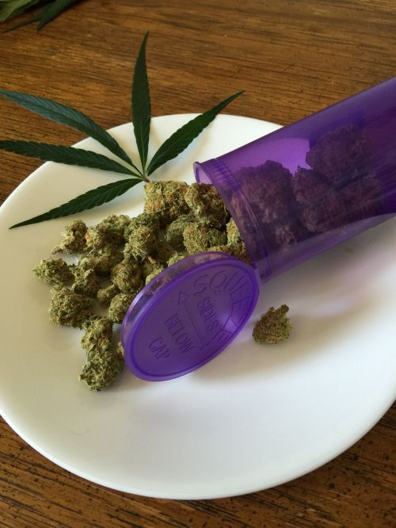
Presentation to City Council (either PRO or CON) regarding expansion of acreage zoned for growing marijuana for medical use

Slide 17

Proposal specifying work to be completed (like a construction or repair project)

Slide 18

Personal trainer’s
fitness plan proposal and justification
for client

Slide 19

Newspaper story with real world length and time constraints

Slide 20

Needs assessment outlining top priorities for needs in a municipality, company or school regarding such issues as:
  Building maintenance
  Environmental pollution
  Aesthetic issues
  Resolving relational conflicts
  Food service

Slide 21

A children’s book for a real audience –
Can be used in almost any subject area

Slide 22

Other ideas for written, verbal, and artistic authentic assignments on handouts

Slide 23
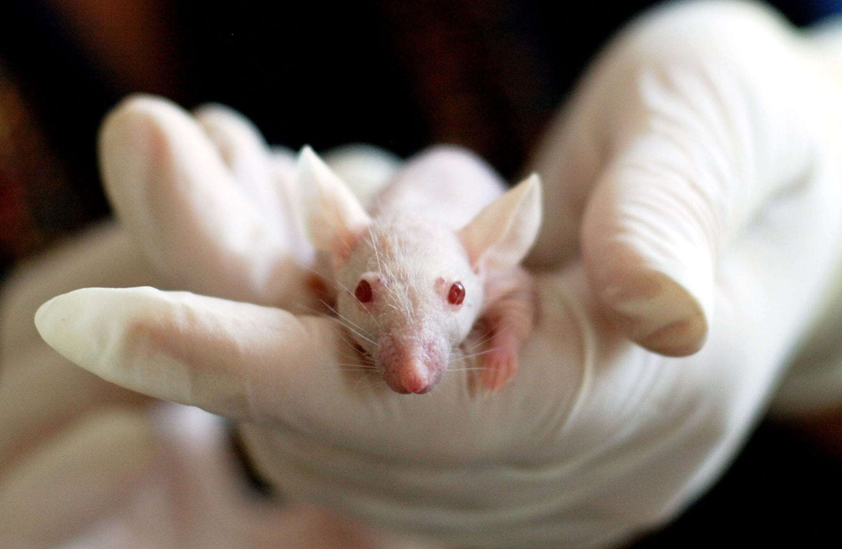
Addressing Issue of
Using Animals to Test Cosmetics

Slide 24
The Real-World Task
Concerned Citizens for Animals (CCFA) wants your company to craft a website that will promote public awareness about the cruel use of animals in cosmetic testing and advocate for a law that will outlaw it. At a minimum, it should include:
  a creative homepage with an interactive element to catch viewer attention
  a page explaining the dangers of animal-tested cosmetics
  a page on how companies can perform these tests to make them safe for human use without using animals
  a page that details the chemistry behind the tests – what toxicity is, how chemists define it, and the reactions of different chemicals used in testing

Slide 25
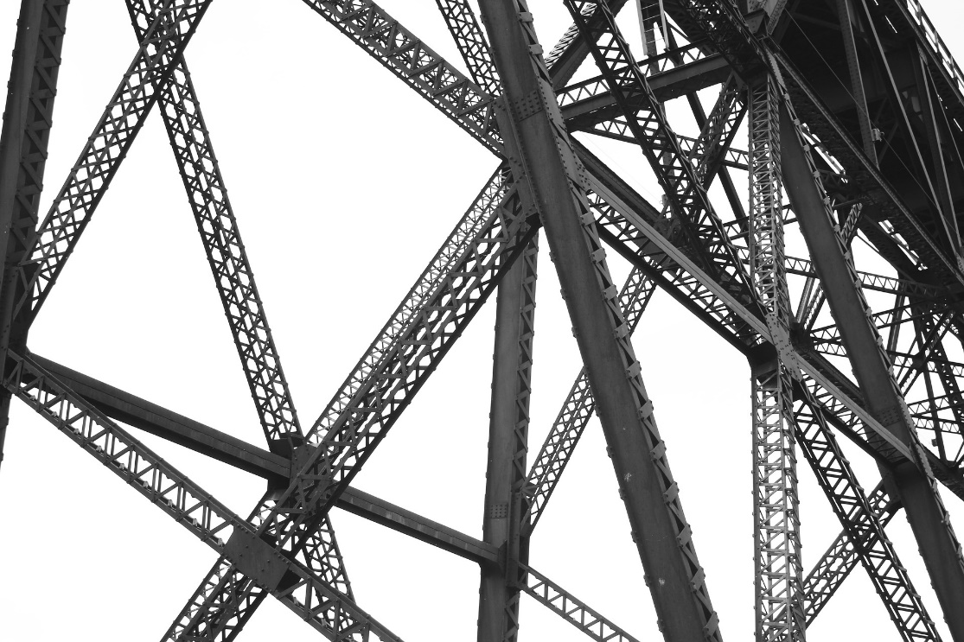
But students need a framework for tackling such a nebulous, multi-step task

Slide 26

Giving students a framework for problem solving is authentic learning that prepares them for the real world.

Slide 27
The Four Ds of Problem Solving
Define
Design
Do
Debrief
From Ted McCain, Teaching for Tomorrow

Slide 28
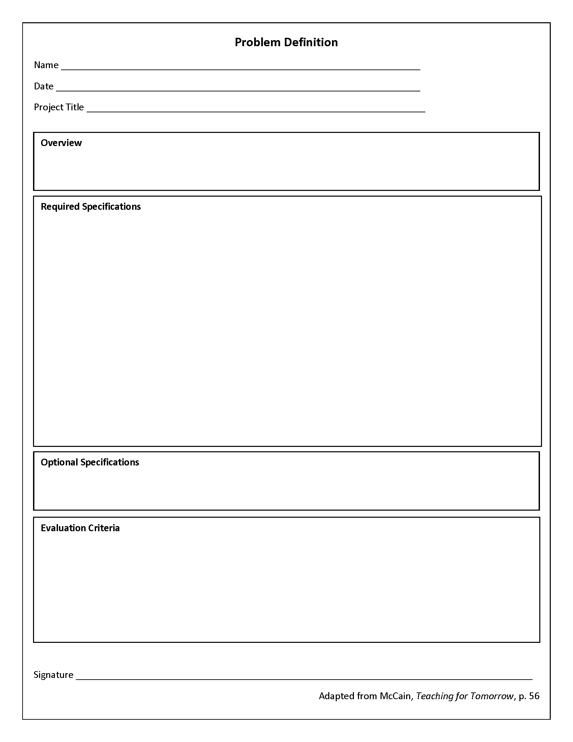
Define
  Overview
  List of criteria or specifications for completing the task (required and optional)
  Criteria for evaluating the product
Notes:
What might be the approaches, strategies

Slide 29
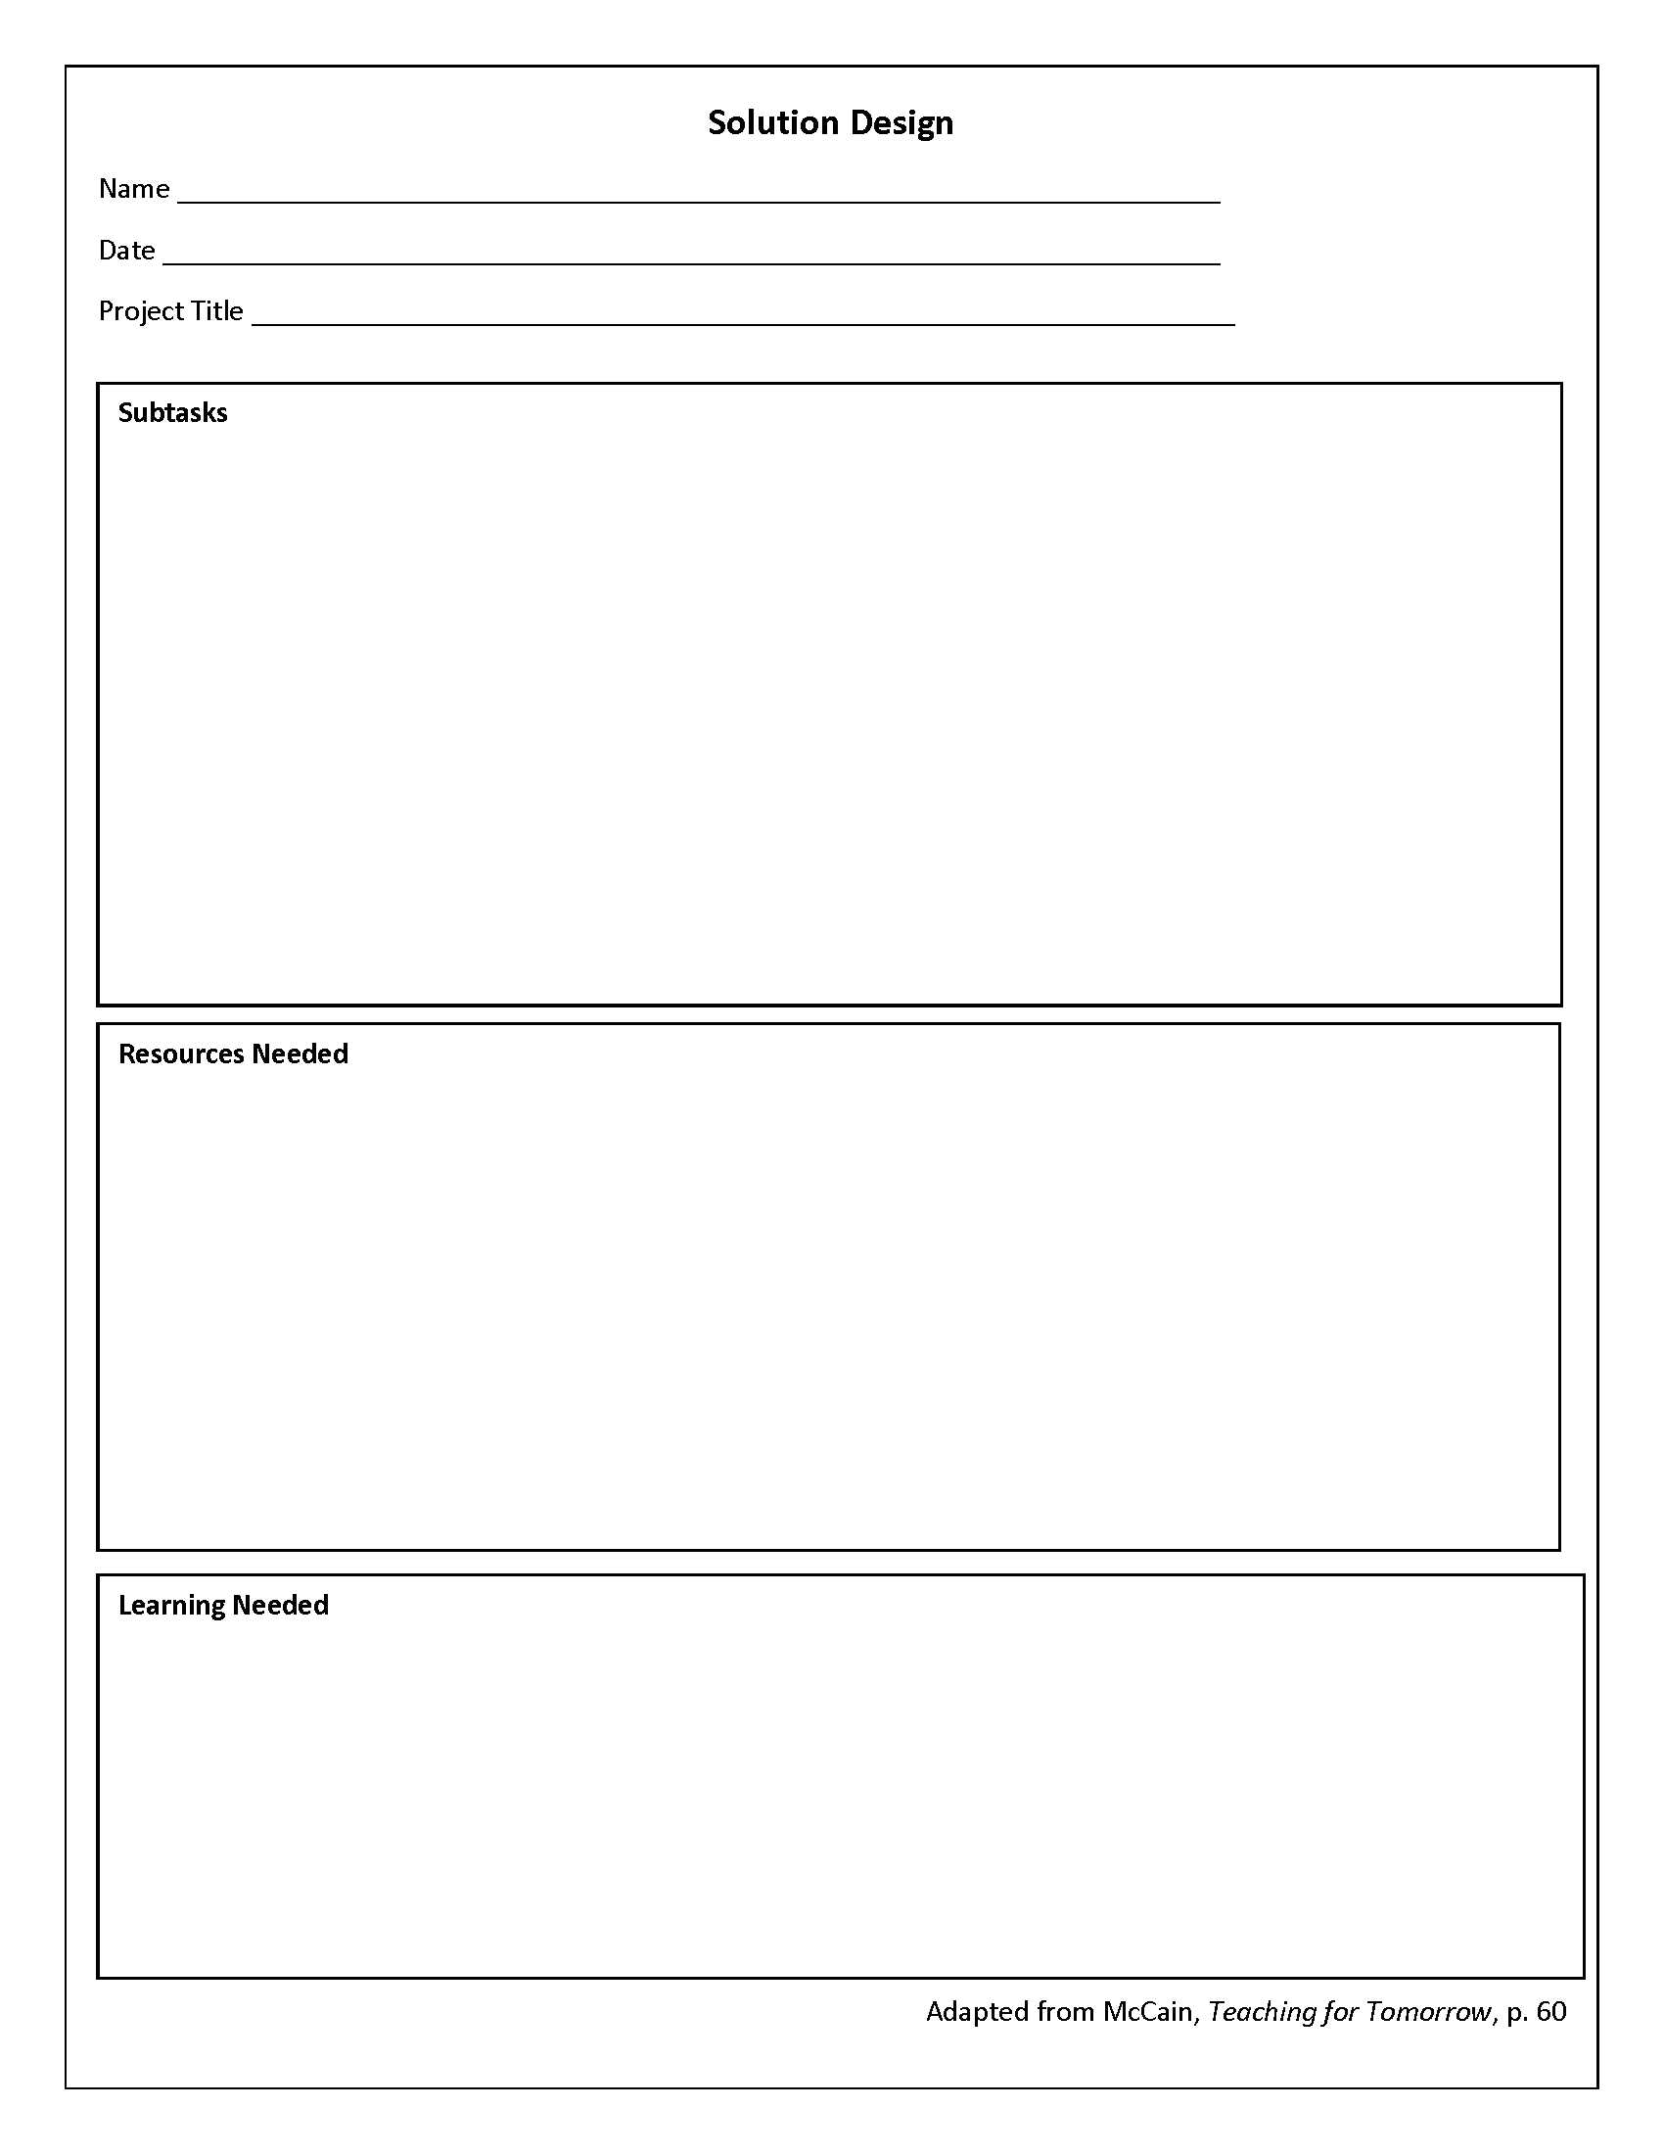
Design
  Outline subtasks
  List of resources needed
  Specify learning needed

Slide 30
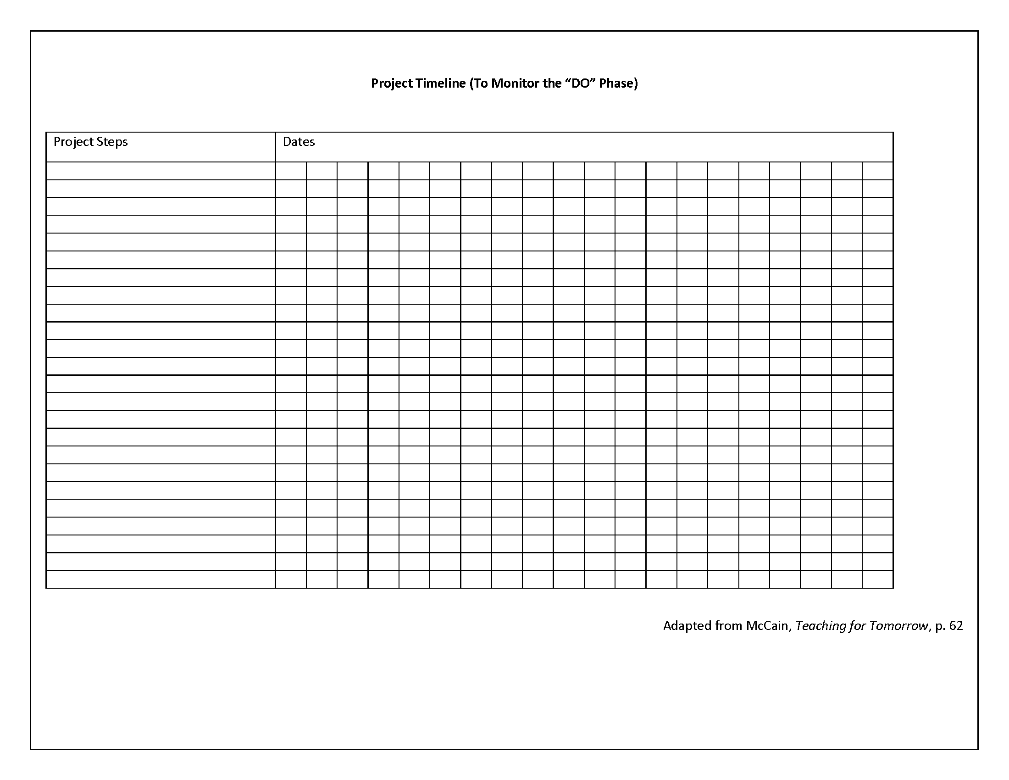
Do
Implement the plan from Design phase
Are we keeping up with the timeline outlined in the design phase?
If difficulties with execution, what could we change about our design plan?

Slide 31
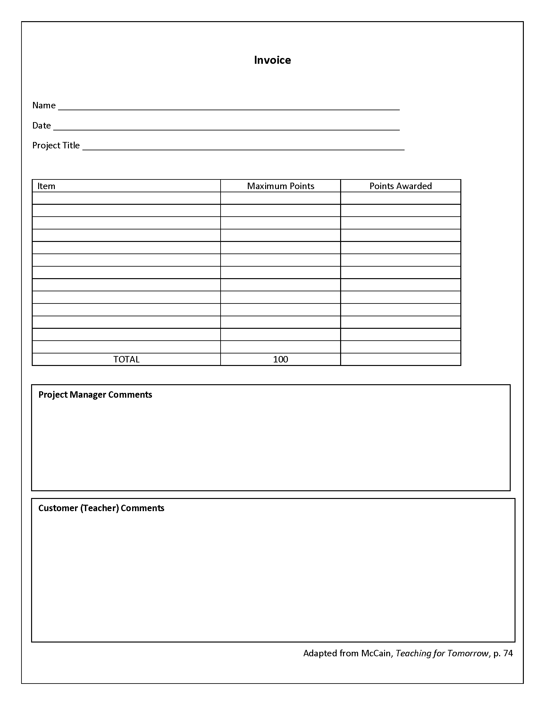
Debrief
  Both teacher and student evaluate the final product, based on specifications outlined in the define phase
  How well has the project met the criteria outlined in the define phase?

Slide 32
The Four Ds of Problem Solving
Define
create a list of criteria for completing the task
Design
identify subtasks, skills and knowledge needed to complete the project
Do
implement the plan outlined in the Design phase
Debrief
have both teacher and student evaluate the final product, based on the specifications outlined in the Define phase of the project
From Ted McCain, Teaching for Tomorrow

Slide 33

Other Frameworks for Tackling
Complex Tasks?
Teachers share other frameworks they may already be using

Slide 34
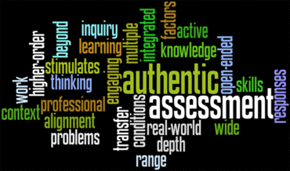
See handouts for additional ideas for alternative assignments

Slide 35
Teacher Small Group Reflection and Share-Out
What upcoming course content would be appropriate for an assignment that has a real audience or resembles a real-world work assignment – or both?
  What standards need to be assessed in such an assignment?
  What alternative ways of assessing skills will students find relevant and engaging?
What are the barriers to implementing this idea in my class? How can I overcome those barriers?
How could I use the 4 D’s of Problem Solving concepts and tools to provide scaffolding for students to attack an authentic task that requires them to work more independently?
How will I know if my authentic assignment for students is successful?

