Slide 1


Using Small Group Learning to Engage Students

Slide 2
Today’s Agenda
Understand benefits of small group learning activities
Experience a small group learning activity
Debrief and discuss planning steps for implementing small group activities effectively
Reflect on applying this experience to own classrooms

Slide 3
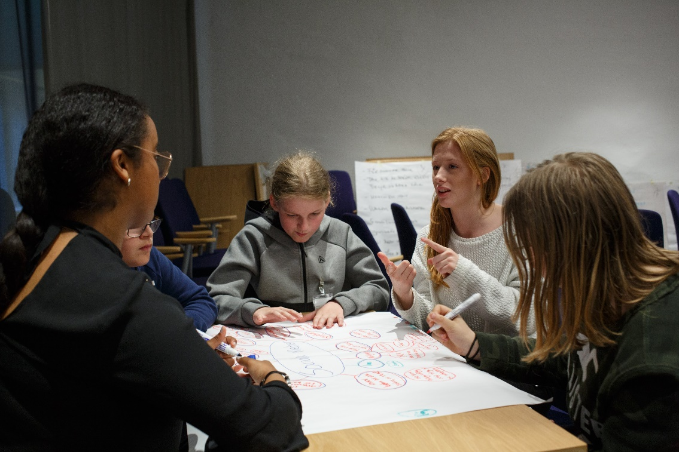
Small Group Learning Addresses Needs for …
Autonomy
Belonging/Connection
Active Engagement
Notes:
Photo by Edvin Johansson on Unsplash

Slide 4
Small Group Learning Addresses CCSS Standards as Students Learn To:
Build on others’ ideas
Express their ideas clearly and persuasively
Work with peers to set rules for collegial discussions and decision-making
Pose and respond to questions
Clarify, verify, or challenge ideas and conclusions
Summarize points of agreement and disagreement
Qualify or justify their own views and understanding
Adapted from CCSS.ELA-Literacy.SL.9-10 Standards

Slide 5
Group Learning Activity

Slide 6
Six Hats (Glasses) Thinking
Teachers experience the role of a student in an activity designed to help students:
  Develop skills in analyzing informational text
  Examine text from different perspectives
  Express their ideas clearly and persuasively
  Clarify, verify, or challenge ideas and conclusions
  Qualify or justify their own views and understanding

Slide 7
Six Hats (Glasses) Thinking
In this activity the group will read an article related to genetic engineering and each group member will respond to the article from a different perspective:
White glasses – focused on information: What are the facts?
Red glasses – focused on feelings: How do I feel about this?
Yellow glasses – optimistic: What’s the upside?
Green glasses – focused on growth and where an idea could go in the future
Purple glasses – focused on judgment and potential negative consequences
Blue glasses – focused on the thinking process: What are the implications?

Slide 8

Teachers engage
in Six Glasses Activity using handouts and instructions

Slide 9
Group members read article silently, highlighting words/phrases relevant to their color’s perspective and making notes as needed.
When all are ready, each person then reflects out loud to the group from the perspective of their glasses color, beginning with the white glasses and proceeding in order. (You can skip colors if you have a smaller group than 6.)
We will follow rest of directions as a large group.

Slide 10
Debrief

Slide 11
What do you see as the benefits of an activity like this for teaching your subject matter?
What possible problems do you foresee in having students do this activity? What could be done to prevent or address these potential problems?
In what ways could you adapt this activity to a future lesson?

Slide 12
Addressing Challenges of Small Group Learning Through Careful Planning and Preparation

Slide 13
Learning Targets
What are the learning targets for students?
How does a small group activity/learning task help students to reach those learning targets?
How will students demonstrate their learning?

Slide 14
Structural Dimensions of
Small Group Learning
Size of group
How students will be assigned to groups
Degree of structure in the activity
Length of time for the activity
How students will be held accountable for their participation in group activity

Slide 15
Getting Students Ready for
Collaborative Learning
Model the strategy (and the roles within the group)
Establish team among students working together
Ensure students understand both individual and corporate responsibility for the project

Slide 16
For those new to implementing successful small group learning:
Start
Small
Start with very small groups (pairs)
doing highly structured activities
for a short duration of time.
GRADUALLY INCREASE
Group size
Length of small group time
Freedom and choice within activity structure
Gradually
Increase
Complexity

Slide 17
Teacher’s Role During Small Group Learning
Circulate and gauge how groups are functioning, redirect as necessary
Implement the system or plan (prepared in advance) for how to support dysfunctional groups
Pose questions to groups to deepen their thinking

Slide 18
Small Group Activity Ideas from Prior Sessions
Venn Diagram Activity
Small Group Analysis Challenge
Silent Discussion Using 4 A’s Protocol
Text-Based Small Group Discussion with Guiding Questions
Analysis Challenge (Critique of Learning Targets/Unit Plan Tool)

Slide 19
Other Small Group Activities Available
Group writing activity (English, History/Government)
Science article discussion activity
Political cartoon analysis activity
Available on website
See handout for website access instructions

Slide 20
Drawing for Glasses Set
Submit your name if you are willing to try the activity (and share glasses sets with other teachers!)

Slide 21
Teacher Self-Reflection
How might I incorporate small group learning into an upcoming lesson/class session? Is there any way I can adapt the Six Glasses activity for one of my upcoming lessons?
What are the challenges I could encounter in using a small group lesson activity, and how could I plan ahead to address these?
How can a small group learning experience make the content more engaging for students? Help to develop students’ higher order thinking skills?
When and with which colleague(s) will I plan to discuss these ideas more?

Slide 22
Additional Teacher Activities for Small Group Learning
To be used or substituted as needed

Slide 23
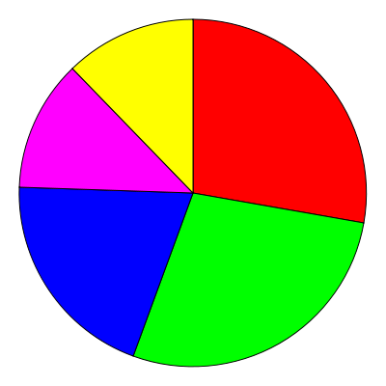
How Do Students Spend Time in Classroom?
Teachers graph how students spend time in their classrooms (see sheets with categories)

Slide 24

Small Group Discussion
In your small group, compare your graphs with each other.
How much variation is there across teachers?
What possible explanations do you see for the level of variation?

Slide 25
Teachers Share Experiences Using
Small Group Activities in Classroom
Teacher volunteers (at least 3) form panel to address these questions before full group:
What small group classroom activity have you tried out in the past month?
What was the learning objective for students?
How did the small group activity work for engaging student interest and effort?
What evidence can you describe of student learning during the activity?
Did anything surprise you?
What challenges did you encounter, and how did you (or would you in future) address them?

Slide 26

Thanks for participating and for your feedback!

