Slide 1


What Motivates Students to Do Academic Work?

Slide 2
Guiding Questions
How do we motivate students to engage in rigorous academic work?
How can we adapt our classroom instructional practices to tap into students’ intrinsic motivation?
How can we do this as a collaborative community?

Slide 3
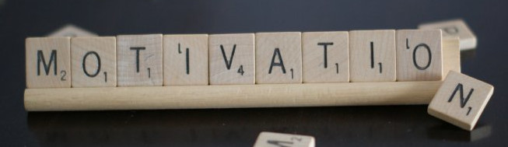
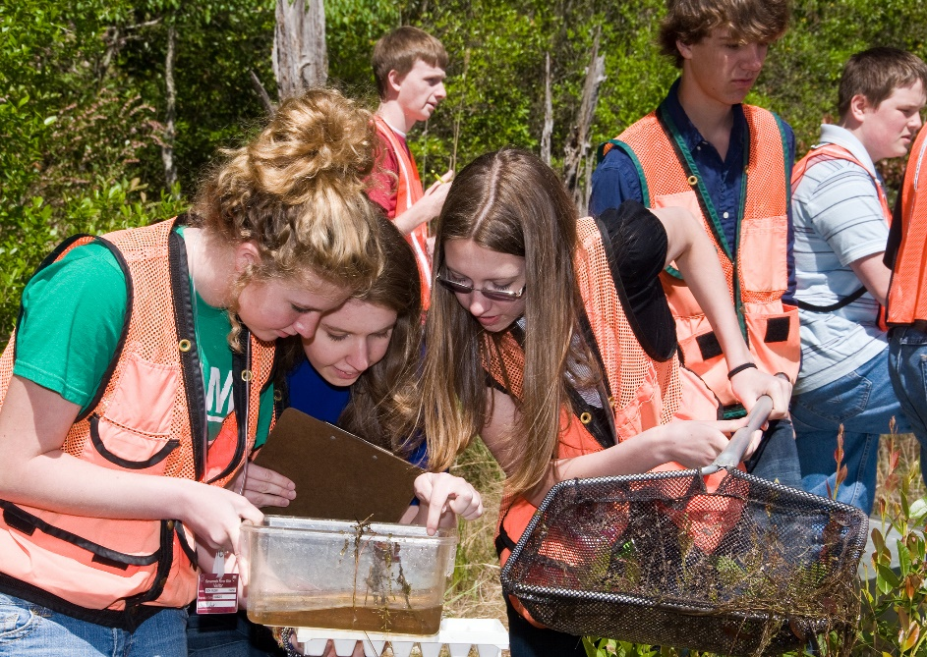
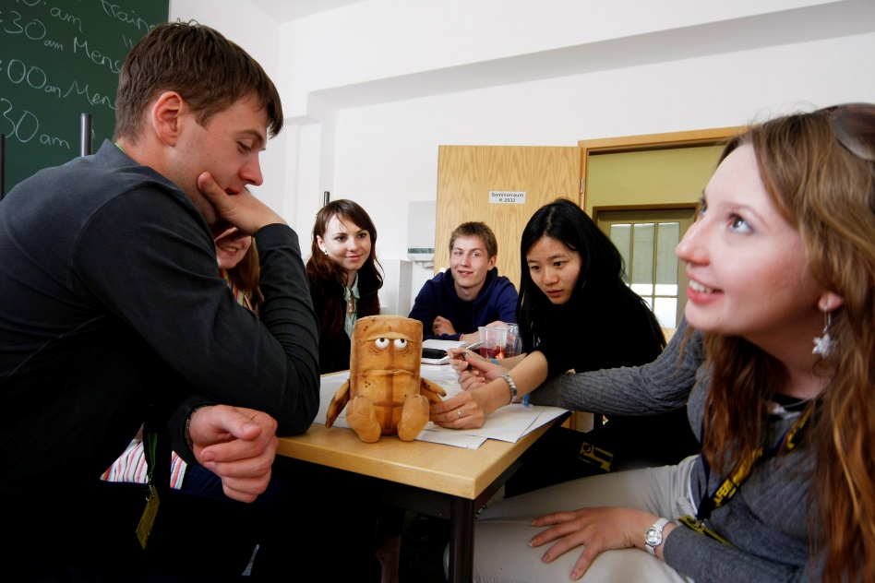
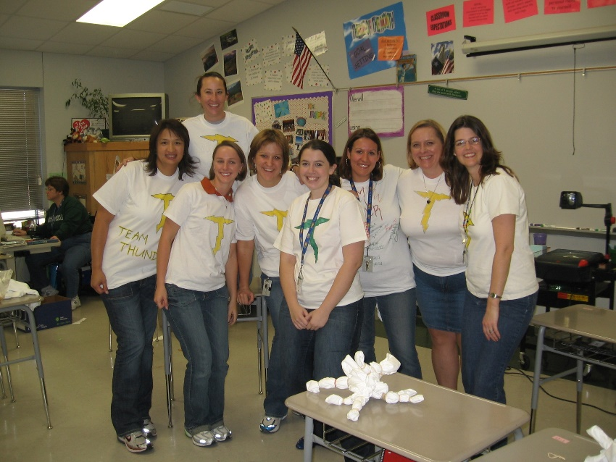
What motivates your students?
What motivates high school teachers?
Notes:
Motivation image credit: https://www.flickr.com/photos/144152028@N08/32985596411/

Slide 4
Brainstorming Exercise
As a group using the large Venn diagram, brainstorm what motivates teachers to do their work, what motivates students to learn, and what, if any, overlap exists between these?

Slide 5
Teacher Motivation
Student Motivation

Slide 6
Rules for Brainstorming
One Conversation at a Time | Encourage Wild Ideas
Go for Quantity | Be Visual
Headline! | Stay on Topic
Build on the Ideas of Others | Defer Judgment – NO Blocking

Slide 7
Brainstorming Debrief
What are some themes that emerge around motivation?
How do themes in the overlap look different for teachers and students?

Slide 8
Motivation Components – BRACE
B
Belonging
R
Relevance
(Purpose)
A
Autonomy
C
Competence
(Mastery)
E
Engaging
Interest

Slide 9

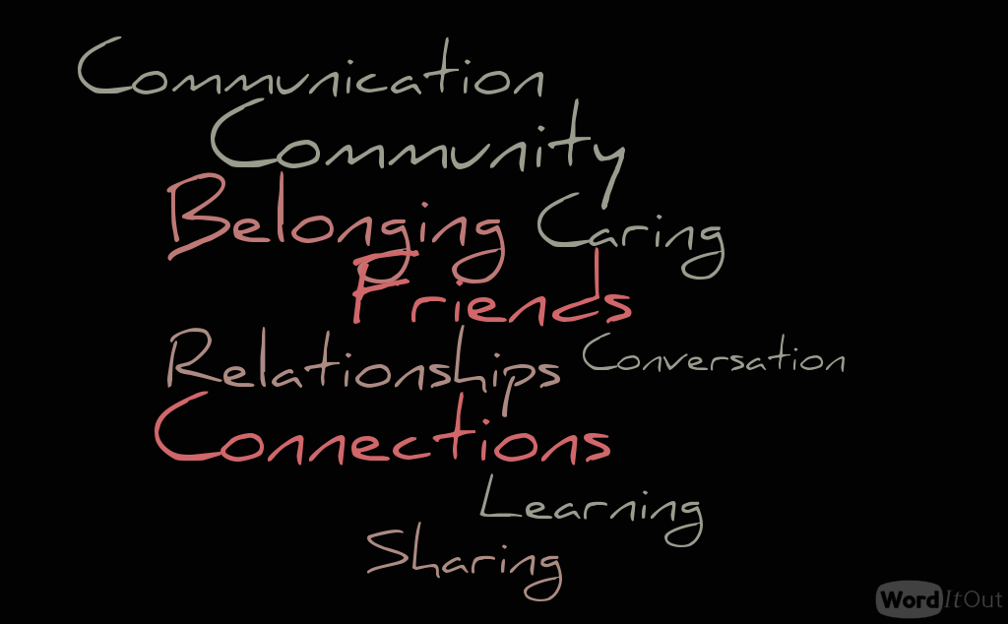
Belonging
Notes:
Image credit: www.worditout.com

Slide 10
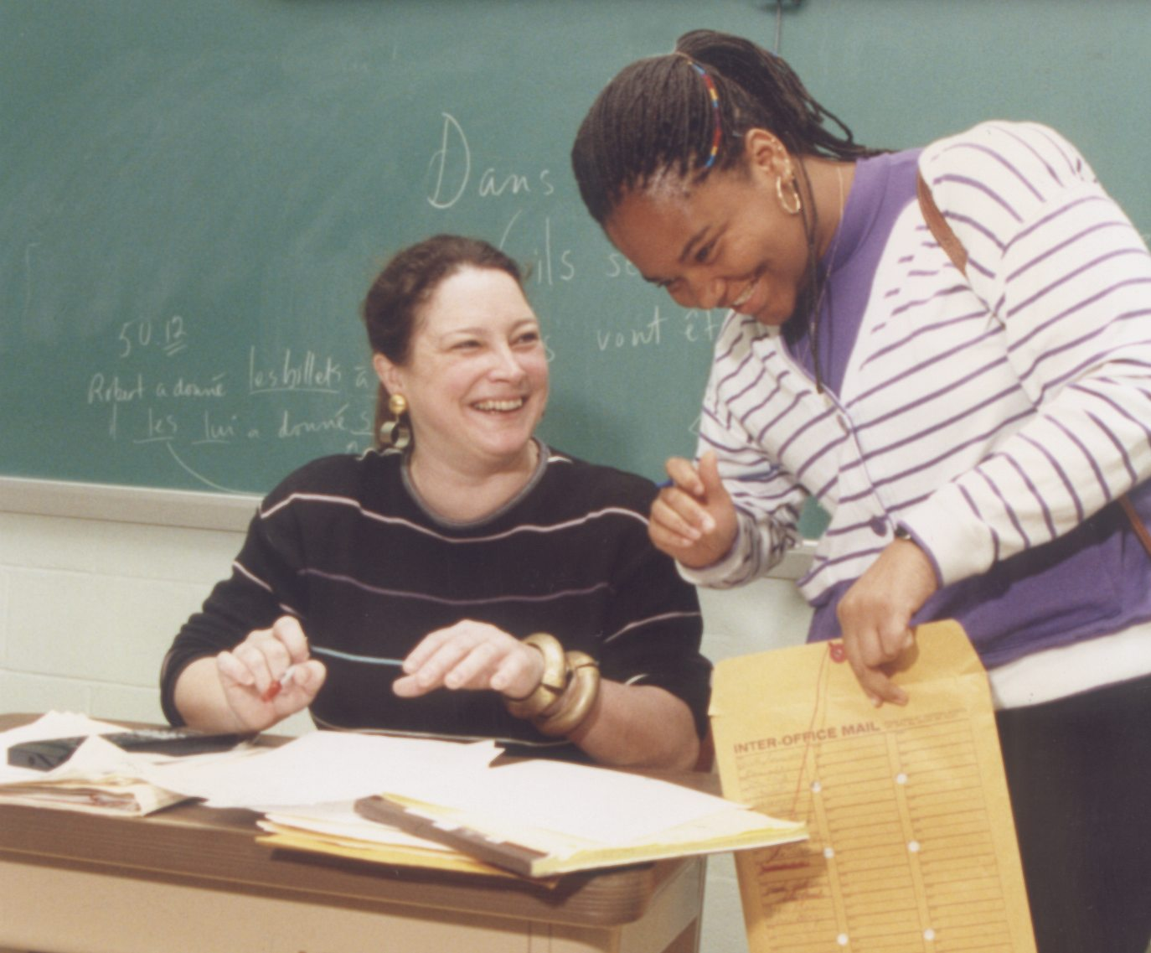
Hunger for Relationships
Listen to some students from a recent study of student perspectives on positive relationships with teachers …
Notes:
Image credit: https://flickr.com/photos/departmentofed/9609016298/

Slide 11
I feel like if anything ever happens, I can go to see him outside of class, and I know he’ll always take a minute from what he’s doing and talk to me in private about whatever it is.
If I ask her a question she’ll really make sure I understand it before letting me go and trying to do it on my own and that’s just really nice because some teachers will be like, “Okay do you have it now?” or “Okay here’s the answer go see if you can do it” but she’ll be like, “Okay do you actually know or do you have any more questions?”
He always has something—some good advice to give you about whatever problems you have. And if he doesn’t then he’ll point you to someone who does.
(from Yu et al., “She Calls Me by My Last Name”: Exploring Adolescent Perceptions of Positive Teacher-Student Relationships, Journal of Adolescent Research, 2018, 33, 332-362)

Slide 12
A Vision of Belonging
VIDEO about Restorative Circles
(Shortened version of https://www.youtube.com/watch?v=RdKhcQrLD1w)

Slide 13
Small Group Discussion Questions
What are your reactions to this classroom experience?
Have you ever experienced this in your own classroom?
What do you see as the pros and cons of using this approach?
What is your favorite way of building classroom community?

Slide 14
Ideas/Resources for Relationship Building (see binder and website)
First-day activities that help you to get to know students – and students to get to know each other
The Power of Personal Relationships article (link on website)
Power of the Circle article (link on website)

Slide 15
Teacher Reflection
What will you do in the first week of classes that will create a community in which students feel safe and engaged?
What will you do to build trust and show caring and respect?
What will you do to sustain this community?

