Slide 1

Teaching
Authentic Problem Solving
Developing greater mathematical reasoning with students

Slide 2
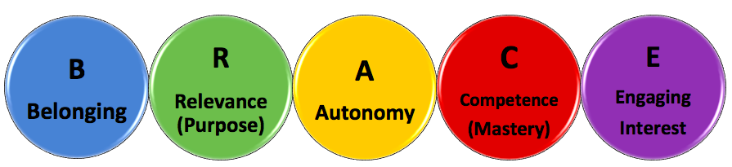
Motivation Components - BRACE
Notes:
Discuss issue of motivating students to work at math, and related to the BRACE slide (some of R A C E in this focus on authentic problem solving??)
Students are motivated when they grapple with challenging questions, when there is productive struggle.
We’ll also be touching on ways that you can engage students through the types of higher order questioning, student discussion and student justification of responses that we are aiming at in the math standards.

Slide 3
Obstacles with Application Problems
1. Lack of initiative.
2. Lack of perseverance.
3. Lack of retention.
4. Aversion to word problems.
5. Eagerness for formula.
From Math Class Needs a Makeover, TED Talk by Dan Meyer, 2010
Notes:
Which of these do you experience in your classroom?
Goals: -Generate mathematical discussion,
-Have students themselves determine what is needed and how (steps and mathematical operations needed) to complete problems
-Have students employ (and become more comfortable with) different problem-solving strategies.

Slide 4
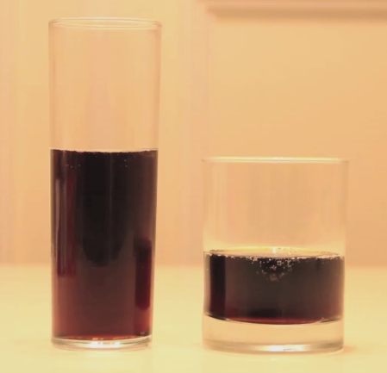
Which one would you choose?
Notes:
-all students can engage, can draw from personal experiences and instinct.
-mathematical language comes in through discourse

Slide 5
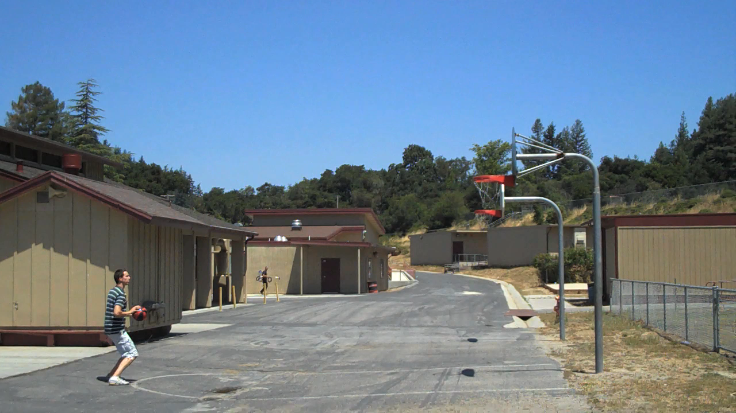
Present students with an image or video
that leads to a compelling question
Notes:
-generate discourse

Slide 6
Which one would you choose?
Notes:
-all students can engage, can draw from personal experiences and instinct.
-mathematical language comes in through discourse

Slide 7
What is this problem really asking?
How would I figure this out?
What information do I need to know?
How do I get the information I need?

Slide 8
Notes:
isn’t something that needs to be filled out completely
can be a verbal exercise, but is equally important that students can develop the ability to answer all of these questions as it is to arrive at the correct “answer” (because it develops mathematical reasoning)

Slide 9
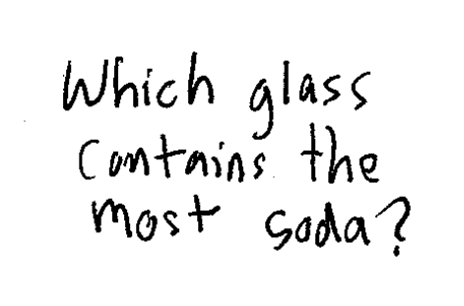
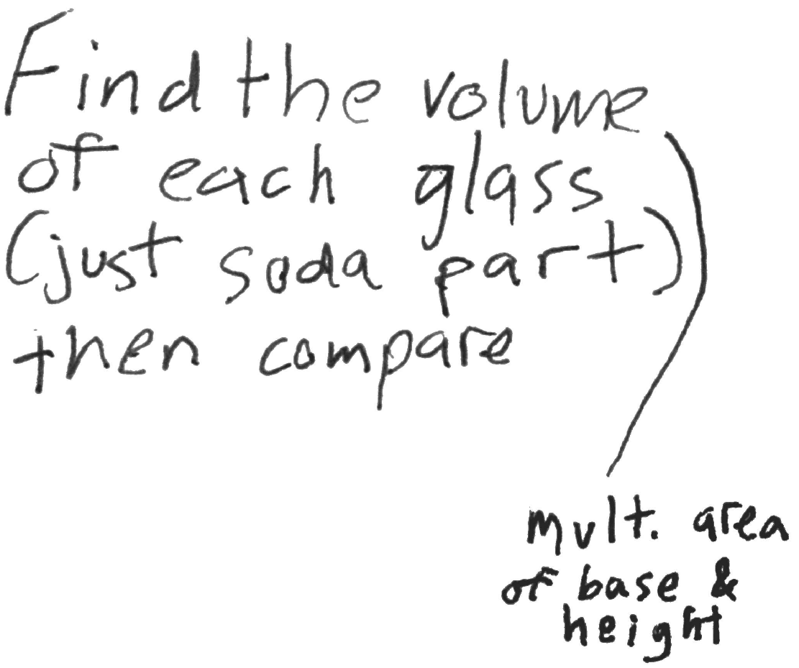
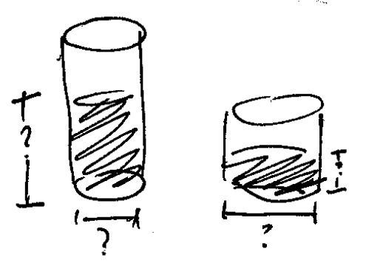
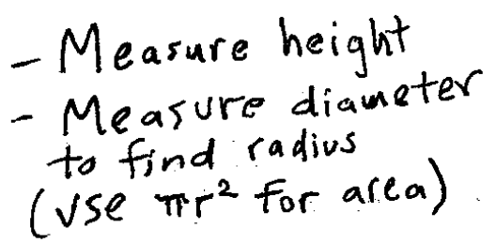
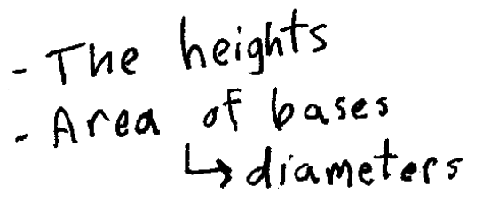
Which would you choose?
Notes:
Graphic organizer is a tool that helps students become more proficient in problem-solving process.
Talk about order. Student’s build off of graphic organizer over TIME – start easy to develop process
Students may not write down all steps, but the process is one they should follow as if second nature
Segway into test prep, how all information is presented, and what we want students to be able to do (articulate problem, develop process, etc.)

Slide 10


Slide 11
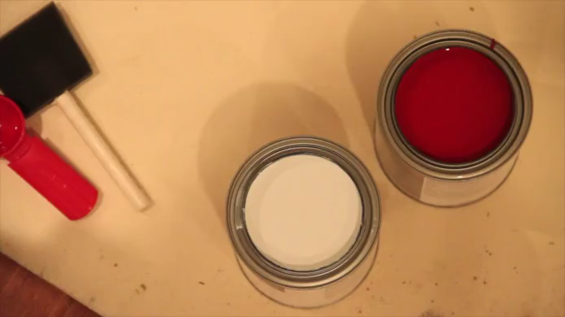
Notes:
-generate discourse

Slide 12
Is it too late?
Notes:
Graphic organizer is a tool that helps students become more proficient in problem-solving process.
Talk about order. Student’s build off of graphic organizer over TIME – start easy to develop process
Students may not write down all steps, but the process is one they should follow as if second nature
Segway into test prep, how all information is presented, and what we want students to be able to do (articulate problem, develop process, etc.)

Slide 13
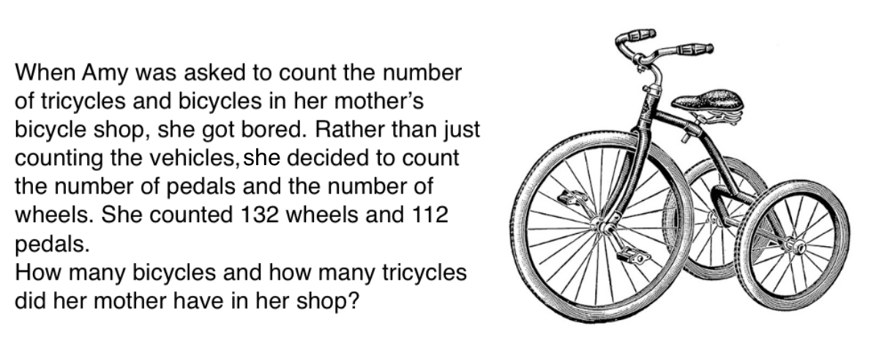
Notes:
-explain that this is the goal
-here students have to determine the question, identify key information, and develop a ‘plan of action’/method.
-skills come last (after all of the above)

Slide 14
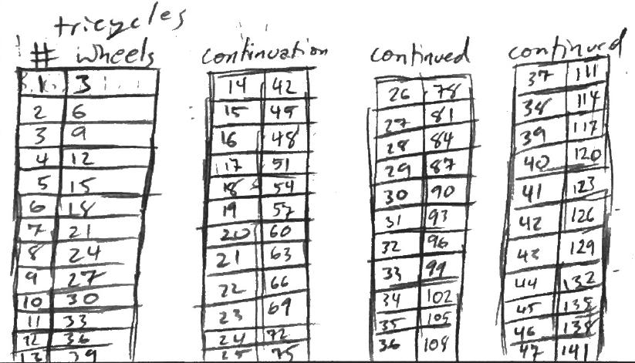
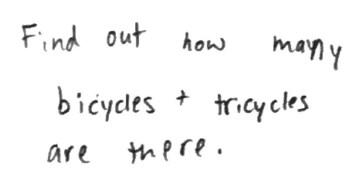
You want students to be able to
Apply their own methods
Articulate what they are being asked to do.
Notes:
-explain where on graphic organizer these go

Slide 15
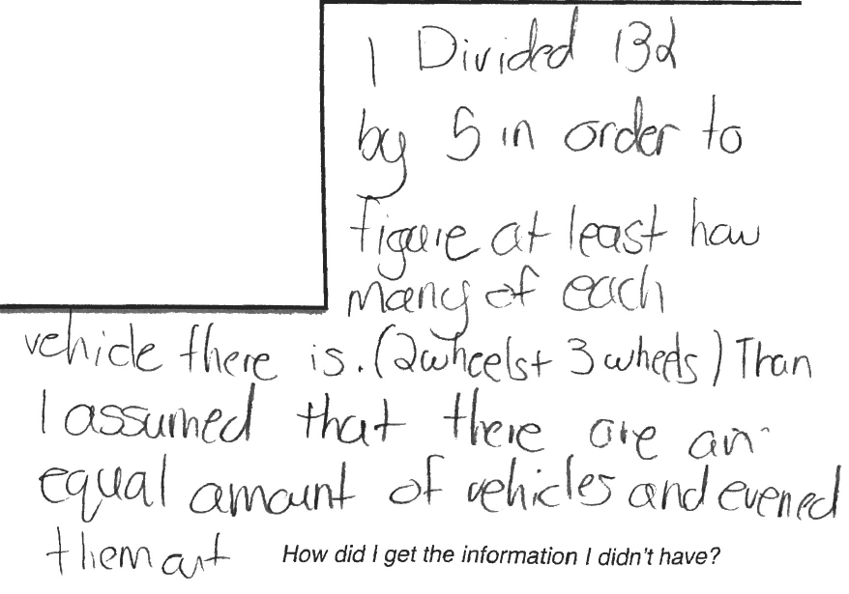
Develop their reasoning and process (even if it’s incorrect!)
Notes:
talk about mistakes – generate class discussion; a place to deepen conceptual understanding

Slide 16
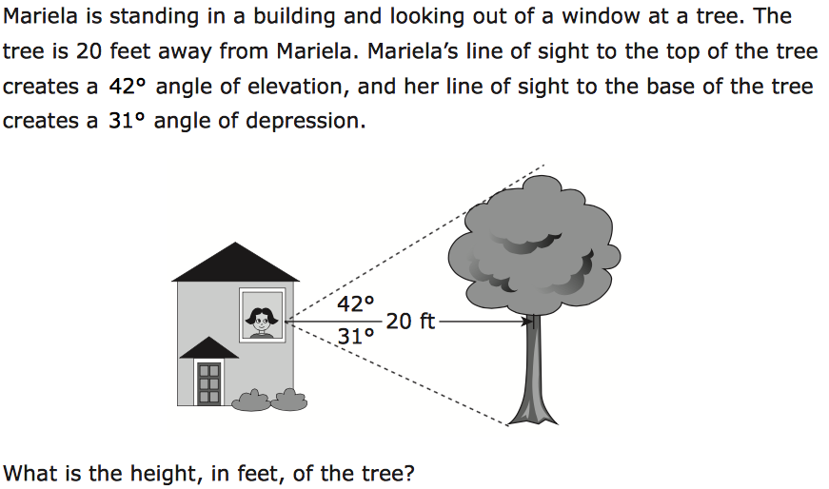
PARCC sample geometry problem
Notes:
-give enough time for them to read problem

Slide 17
20 ft.
Notes:
-bring post-its and a marker to supplement information (if needed)
-20 appears, 42 & 31 angles don’t
-model entire process of proving information as needed

Slide 18
Key Takeaways
1. Present a compelling question.
2. Guide students (vs. explicitly show).
3. Encourage and facilitate discourse.
      Students develop process
      Students identify key information
4. Validate multiple methods and strategies.
Notes:
Which of these do you experience in your classroom?

Slide 19
Some additional resources…
blog.mrmeyer.com
3 Act Math
www.mathalicious.com

