Slide 1


Assessment Strategies that Motivate Students

Slide 2
Focus Questions
What are our goals for giving grades and how do grades influence future student performance?
How might we design grading scales that support student motivation?

Slide 3
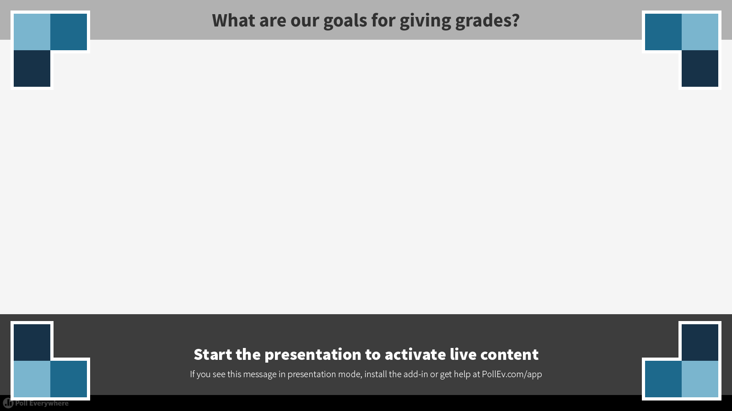
Notes:
What are our goals for giving grades?
https://www.polleverywhere.com/free_text_polls/bxcvsjVuy4Lnfo5

Slide 4
Motivation Components – BRACE
B
Belonging
R
Relevance
(Purpose)
A
Autonomy
C
Competence
(Mastery)
E
Engaging
Interest

Slide 5
Grading Policy Exercise
Scenario – A teacher has unfortunately taken ill and had to take an unexpected leave of absence. You have been given that teacher’s gradebook and asked to assign grades for the semester.

Slide 6
GRADES
C
C
Missing Assignment
D
C
B
Missing Assignment
Missing Assignment
B
A
Calculate the final grade for this student who received the following 10 grades during first semester.

Slide 7
What’s Your Grade?
Share with your table partners and discuss any differences in grading decisions noticed.

Slide 8

How many tables had complete agreement?
Our next activities will explore some of the reasons behind divergent views.

Slide 9

Meaningful Grading
Modified Jigsaw
Informally group yourselves in 3’s or 4’s
Identify members as A – B – C
A’s read: Practice
B’s read: Problems with Percentage Grades
C’s read: Missing Assignments – The Distortion of Zero

Slide 10
“Zeroing” in on the Assessment Issues
Large Group Discussion
What did you see about the impact of specific grading scales and weighting policies?
Should improvement over time be taken into account in grading (earlier, low grades thrown out?)
How should missing/late assignments be handled in grading?
Notes:
Summarize overarching themes in the texts. We are going to “discuss” these issues in a non-traditional way….

Slide 11
The Great Grading Debate

Slide 12
Agree – Disagree Directions
Everyone stand up!
There are three posters along a line in the room – AGREE, DISAGREE, and NOT SURE/NEUTRAL.
I will post a statement and read it aloud. When I do so, silently move to the poster that reflects your opinion on the statement (Agree, Disagree, Not Sure/Neutral)
Once you are there, either independently or with others around you, craft persuasive arguments for your position – be prepared to share out!
If your opinion changes based on what someone else says – move!
Notes:
Note that this strategy can be adapted in multiple ways for classroom use – instructions in binder.

Slide 13
Statement:
Missing assignments should receive a 0 on a 100 point scale.

Slide 14
Statement:
Teachers should take account of improvement over time in assigning the final grade (by dropping or giving less weight to earlier low grades).

Slide 15
Statement:
There should be few if any opportunities to redo assessments or tests for a higher grade.

Slide 16
Statement:
Averaging grades on a 0 to 4 point (F to A) grading scale is more fair than using a straight 100 point scale.

Slide 17
How the 100 Point Scale and the 5 Point Scale Lead to Different Final Grades
Grade (100 pt) | 0 | 93 | 93 | 93 | 93 | 93 | 0 | 0 |  | 56 | F
Grade (5 pt) | 0 | 4 | 4 | 4 | 4 | 4 | 0 | 0 |  | 2.4 | C
Weight | 10% | 10% | 10% | 10% | 10% | 20% | 20% | 10%
Notes:
Should we show this before people choose their sides in the debate? Same with next slide?
Questions: Is this surprising? How do you account for the discrepancy in the final grade?

Slide 18
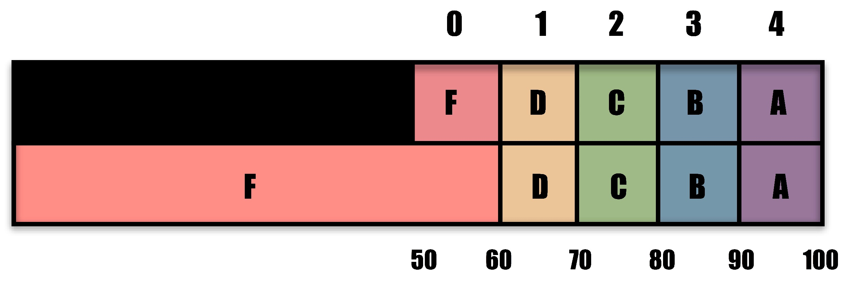
Scaling Differences

Slide 19
Self-Reflection
Based on the conversation and debate, what new thoughts do you have about grading? Which of your ideas about assessment practices have been confirmed, challenged or changed?
Given our conversation, what might you do differently this school year?
Notes:
This can be eliminated if there are time constraints, since we are moving right into Part 2.

